Slide 1
Control system for electric motorcycle
Cole fuerth eet 617 capstone project presentation

Slide 2
Project members
I am the only official member of this project
I had help with mechanical build from Scott MacKay, Brian Fuerth, and Allen Repmann, who are all experienced machinists or fabricators
I had some electrical assistance with analog processing circuits from Marko Jovonovic and John Schlichther
Andrew Dolas is a Computer Science student that taught me how to use pointers properly, and pointed out some ways to make the program more efficient

Slide 3
Description of project
My project is a control system for an electric vehicle
Operates in the Arduino ecosystem
User experience includes some safeties and performance modes, as well as active telemetry and light control

Slide 4
Discrete systems within the vehicle
Light control
Analog monitoring of control and motor currents, 4S cell voltages, total battery voltage
Control of the electric motor, using in/out of gear, a motor contactor, some performance modes, and a twist throttle, repeated with a power amplifier from the processor
Fault handling concerning telemetry, motor control, program methods, digital comms
HMI interface

Slide 5
Light control
There are hand controls on each handlebar, used to control the lights, kill switch, in/out of gear, and horn.
There is a switch to kill all lights on the vehicle, as a ‘dark mode’
Turn signals, bright/low headlight, taillight/brake light, and fog/trail lights are all present

Slide 6
Analog stack
The analog stack handles all analog signals in and out of the processor
Opamps handle linear signals, and Instrumentation Amps handle differential signals
A power amp is present, to provide a current source to the throttle out level

Slide 7
EV Controller interface
There is a panel dedicated to the interface to control the EV Controller
There is a 200A Solenoid contactor on the positive input to the controller, allowing the user or processor to pull power to the controller in the event of emergency
Relay pack provides control for controller performance profile, and processor interface with the motor contactor
A 150A current shunt is present on the negative battery terminal, for current measurement.

Slide 8
Fault handling
Faults are a core system overseeing all discrete systems within the vehicle ecosystem
“Level 1 Faults” are critical faults which when present, open the motor contactor. Level one faults, after a fault reset, require the operator to open and close the kill switch before re-engaging the motor contactor
Faults exist for program exceptions, analog value exceptions, HMI watchdog, digital input comms, and other misc. items

Slide 9
Hmi interface
A Nextion 3.2” Standard model is used as an HMI
HMI has screens called: “Main”, “Status”, “Alarms”, and “Settings”
Active telemetry, faults, the current time, and some performance settings are all available on the HMI

Slide 10
Background concepts
Operational Amplifiers
Instrumentation Amplifiers
Diode analog safeties
Voltage Dividers
Serial communications using serial buffers
Relay outputs / opto-isolated inputs

Slide 11
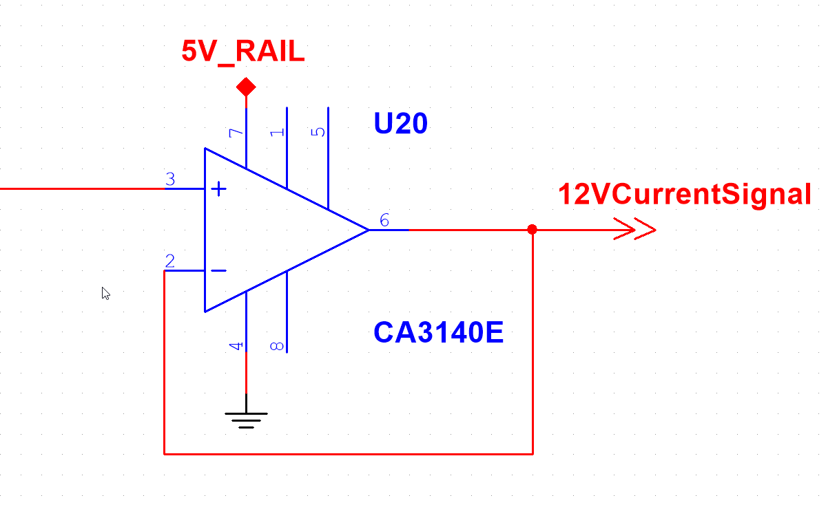
Operational amplifiers
Operational Amplifiers were used as voltage buffers
Voltage Buffers behave linearly, repeating any voltage on the input as the output, so long as the input is within the rail voltages

Slide 12
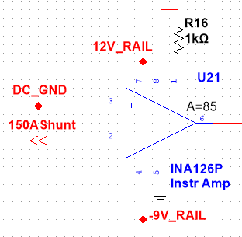

Instrumentation amplifiers
Instrumentation Amplifiers, also known as “Differential Amplifiers”, generate an output potential proportionate to the difference of the input pins, multiplied by a gain set with a gain resistor.
The INA126P Instrumentation amplifier was used with gain resistors of 1.46k and 1k resistors, and without gain resistors to measure individual 4S cell voltages within the 16S pack.
$$V_{out}=\left({in}_{+}−{in}_{−}\right)∗(5+\frac{80kΩ}{R_{G}})$$

Slide 13
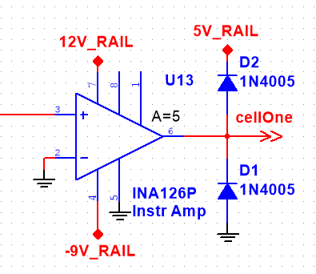
Diode safeties
By using a diode and a reference, a signal can be prevented from crossing above or below reference level using a diode.
This is useful, when using +12V or -9V rails with opamps that feed directly into a TTL processor, since the processor would fail if given these levels.
Diodes and references keep output level between -0.7V – 5.7V on this instrumentation amp operating on +12V and -9V rail potentials

Slide 14
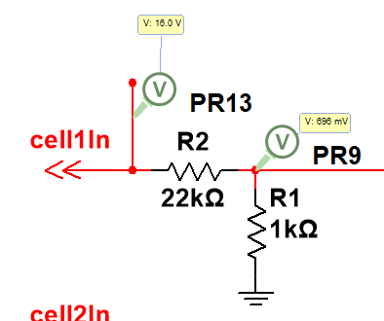

Voltage dividers
Voltage dividers consist of two or more resistors in series, ‘dividing’ an operational voltage down to a useable signal level.
$V_{out}=V_{in}(\frac{R_{1}}{R_{1}+R_{2}})$

Slide 15
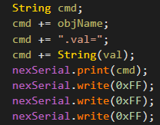
Serial buffers
Custom serial methods were made to replace the Nextion libraries in the interest of speed and efficiency.
Each serial message begins with an initializer, 0x65, contains a message, for example, “baud=115200”, and is followed up with 0xFF written three times.

Slide 16
Isolated digital io
Isolating digital IO can be accomplished using Opto-Isolators and Relays.
Inputs are Opto-isolated from 12V active-high to 5V active-low
Opto-isolators operate using an LED transmitter and a phototransistor receiver; power at the LED side provides a ‘short’ at the phototransistor side.
Relay outputs are used for operating 12V control circuits using a 5V processor. Outputs are opto-isolated, then the opto-isolators use 5V aux power to power a relay coil.

Slide 17
design
Block Diagram
Electrical Design
Mechanical Design
Panel Layouts
Program Design
HMI Design

Slide 18
ELECTRICAL DESIGN
Electrical design was done in MultiSim
Each discrete system was made individually in MultiSim and tested before construction
Analog circuits were made on soldered breadboards

Slide 19
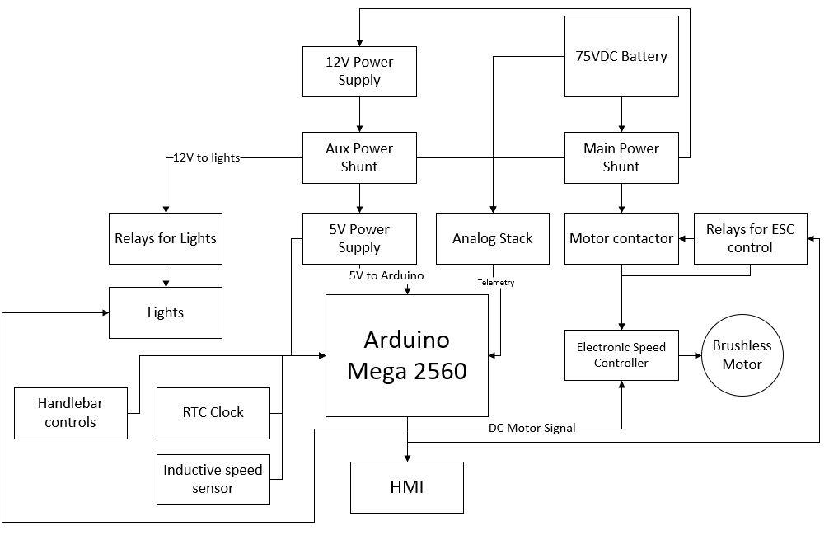
BLOCK DIAGRAM

Slide 20
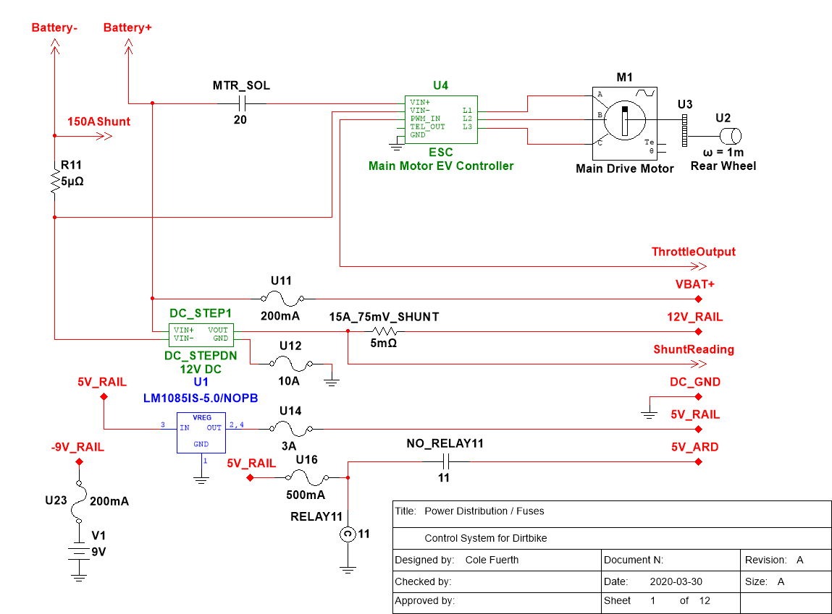
POWER DISTRIBUTION

Slide 21
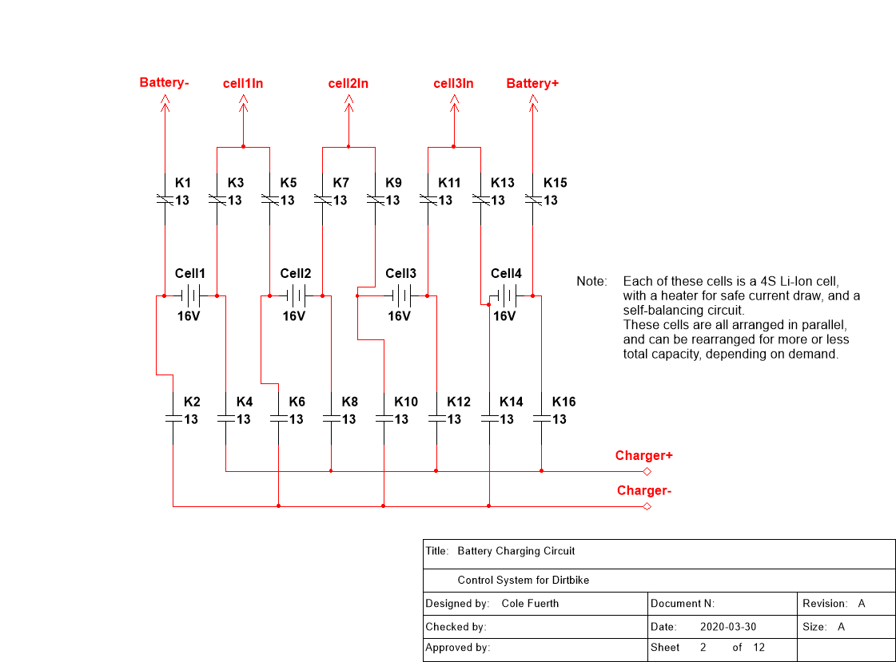
BATTERY SCHEMATIC

Slide 22
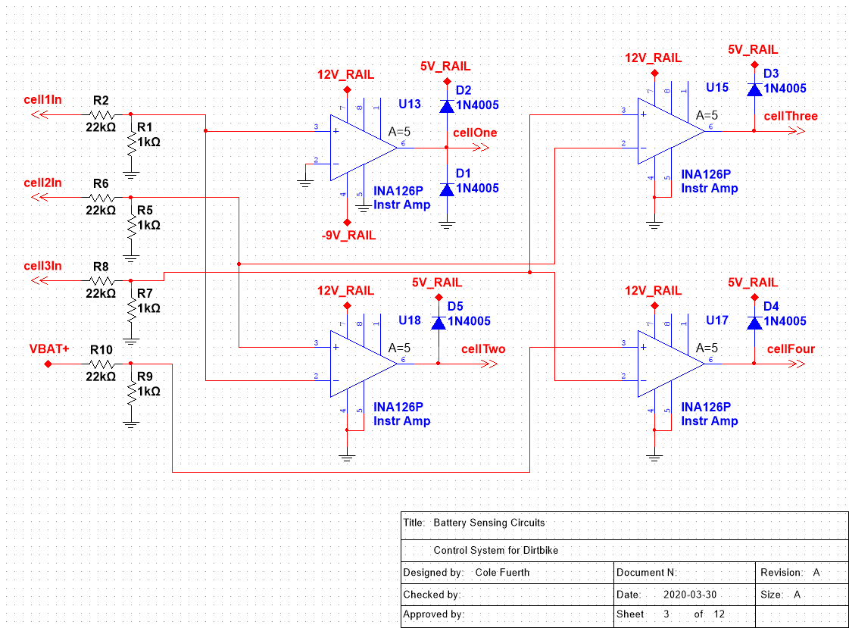
BATTERY CELL SENSORS

Slide 23
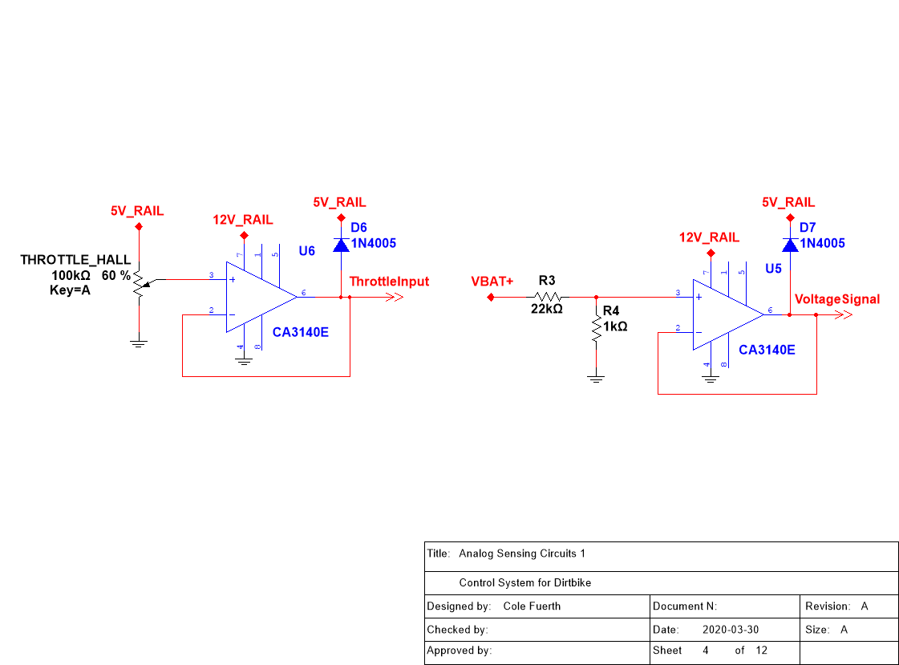
VOLTAGE BUFFERS

Slide 24
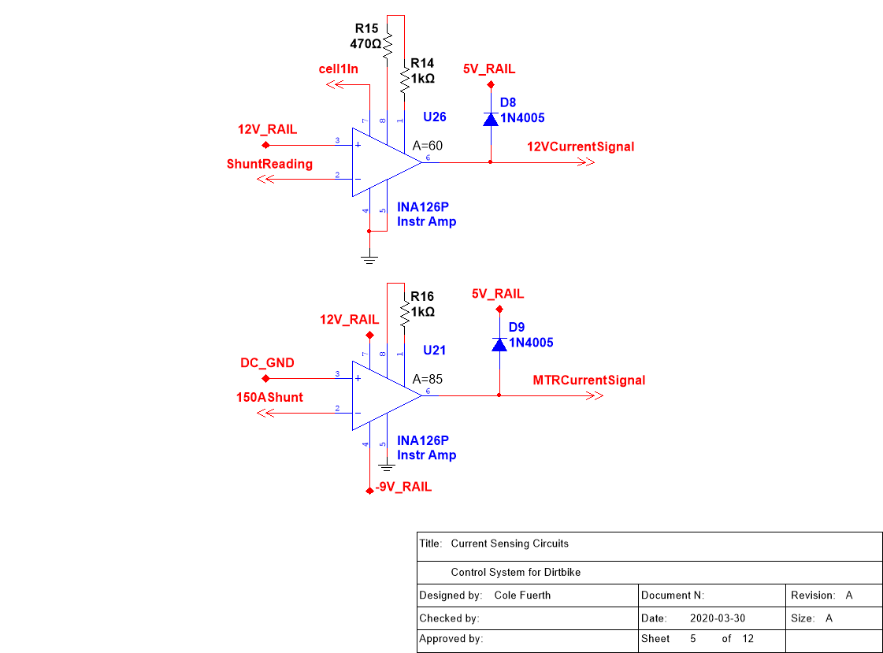
SHUNT AMPLIFIERS

Slide 25
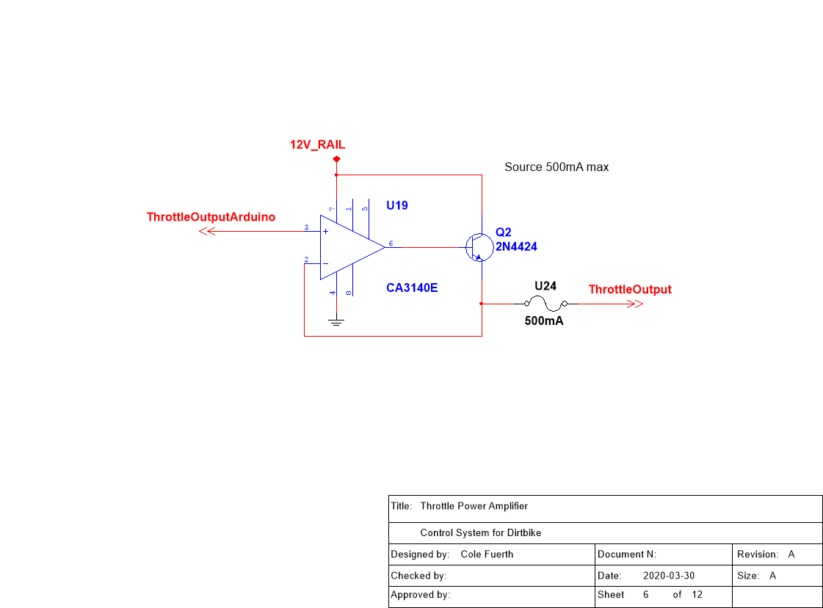
THROTTLE OUT POWER AMP

Slide 26
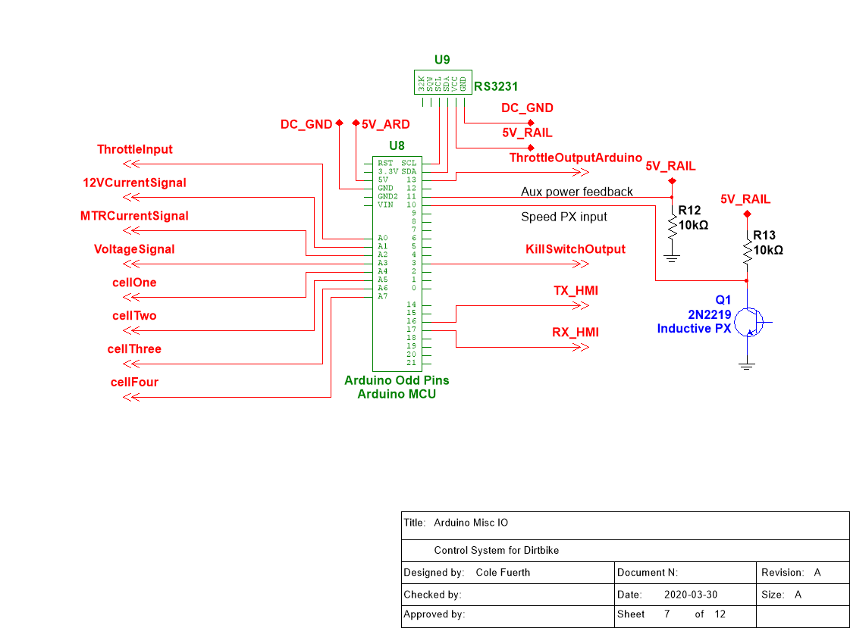
ARDUINO IO 1

Slide 27
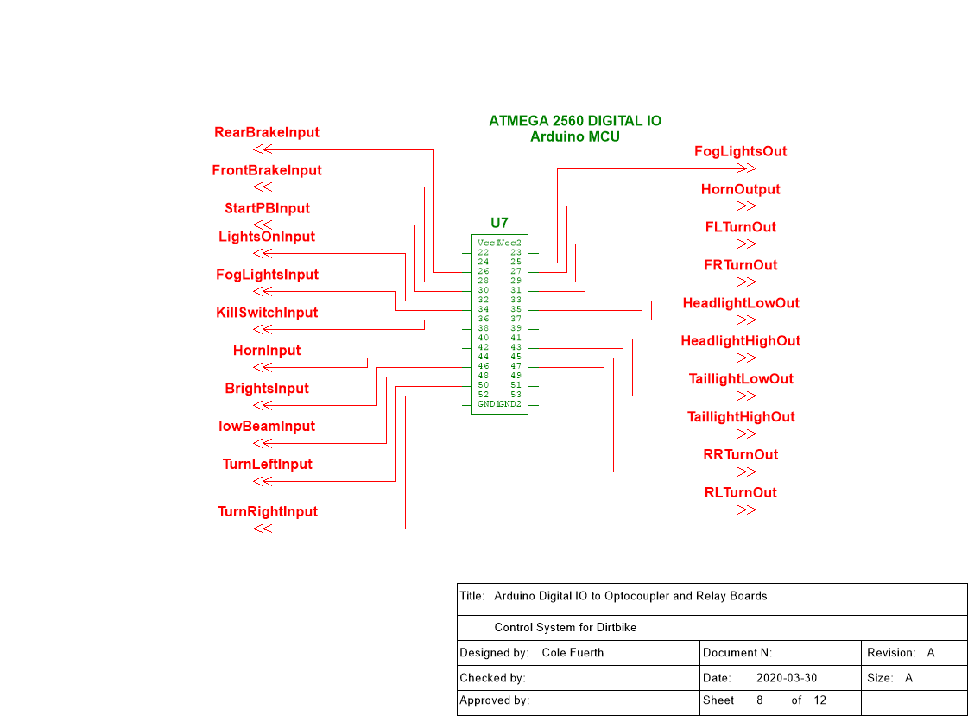
ARDUINO IO 2

Slide 28
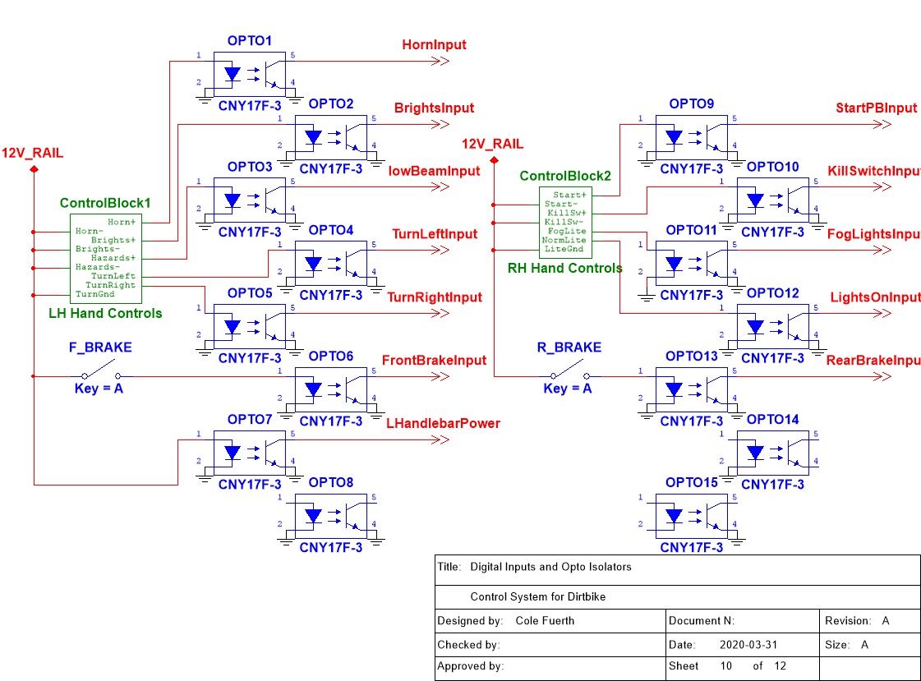
OPTO BOARDS

Slide 29
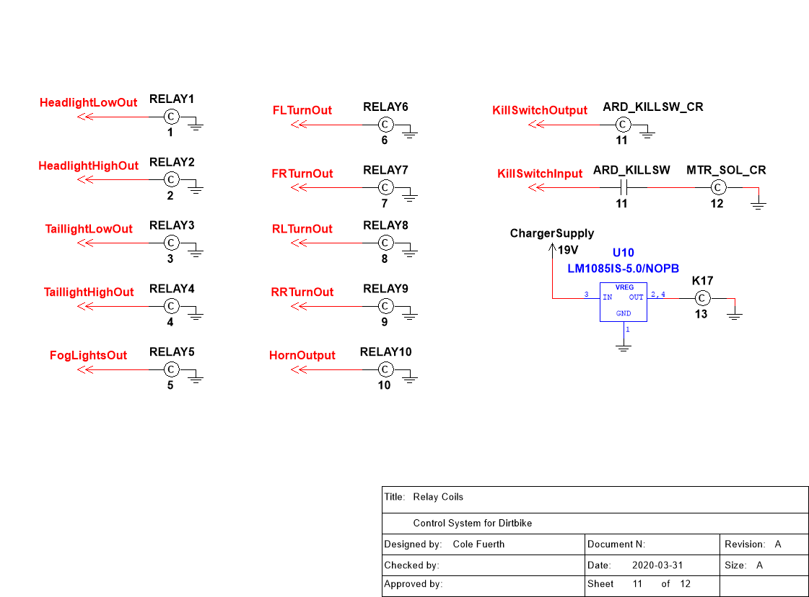
RELAY/SOL COILS

Slide 30
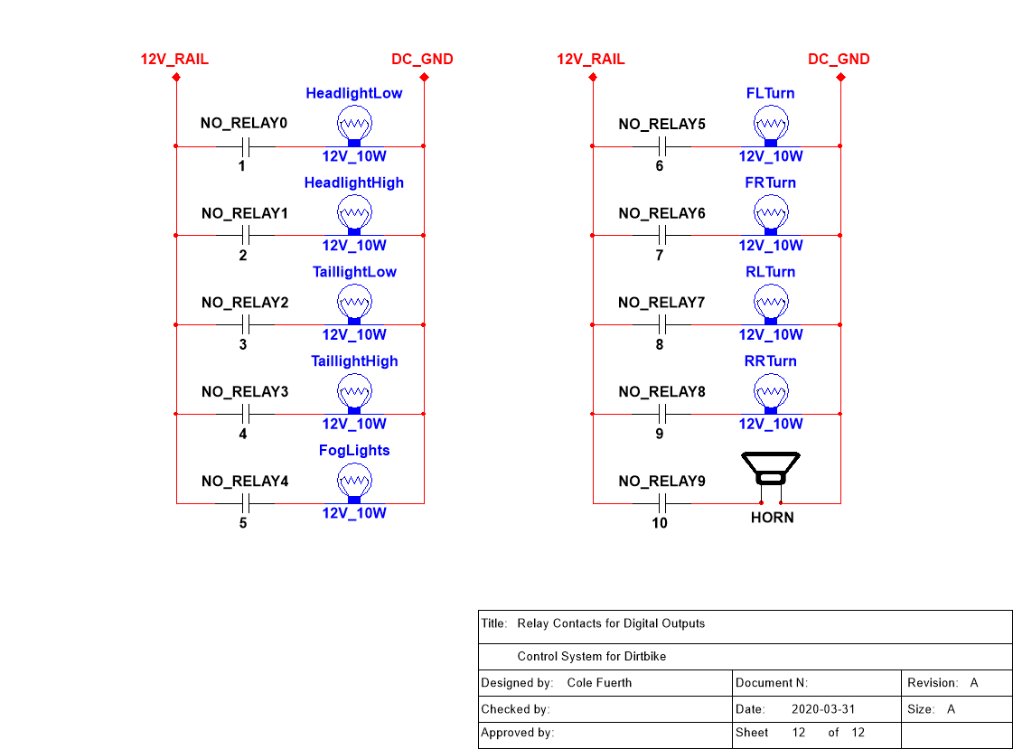
LIGHT/12V CONTROL

Slide 31
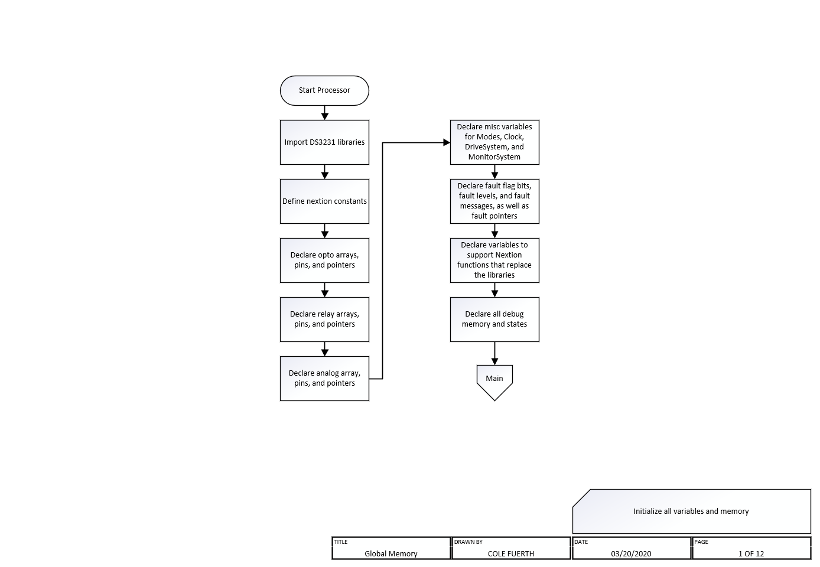

Slide 32
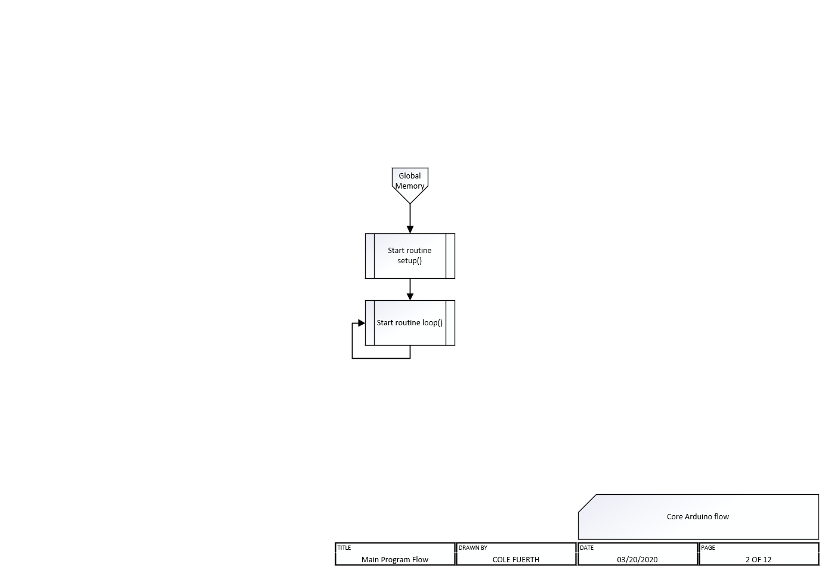

Slide 33
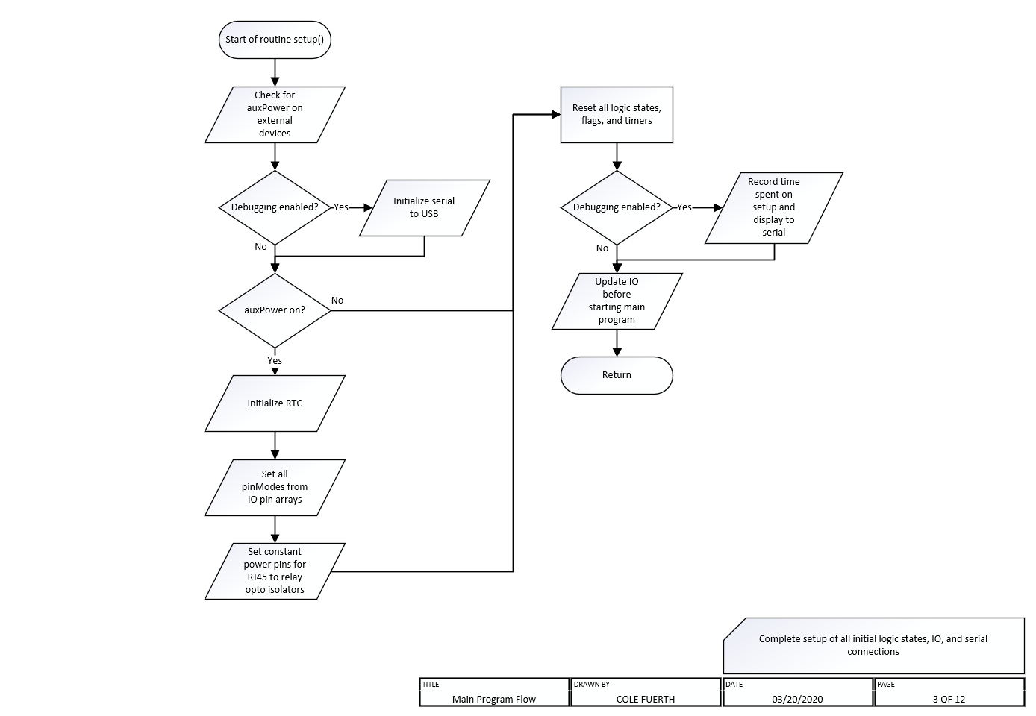

Slide 34
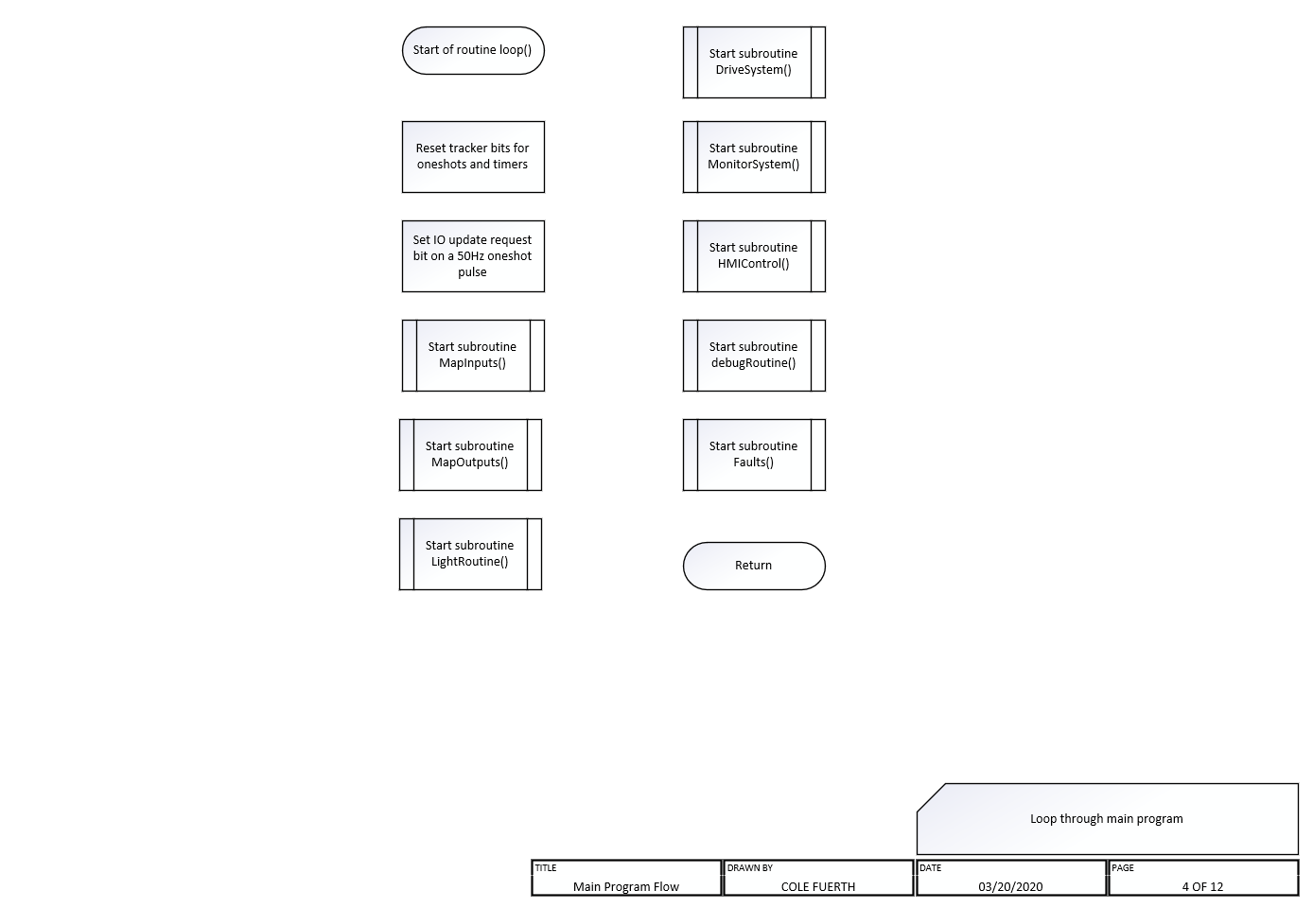

Slide 35
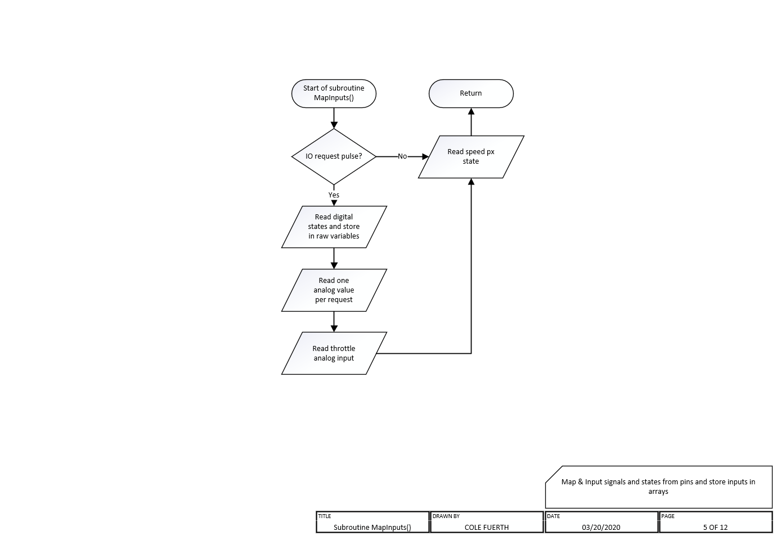

Slide 36
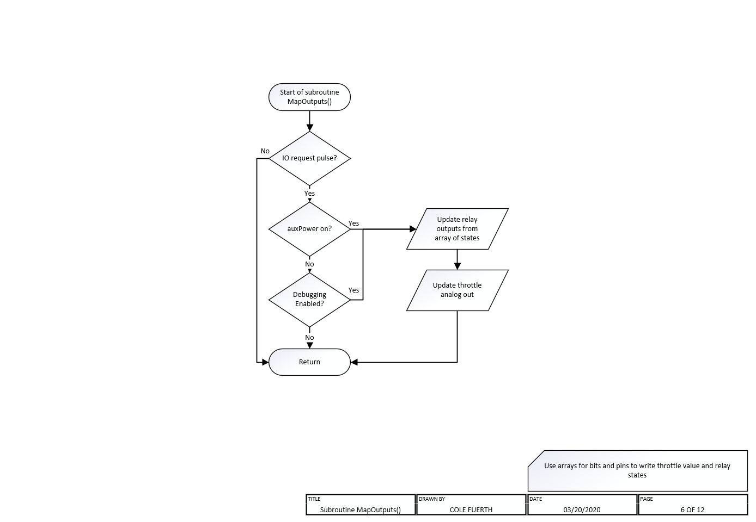

Slide 37
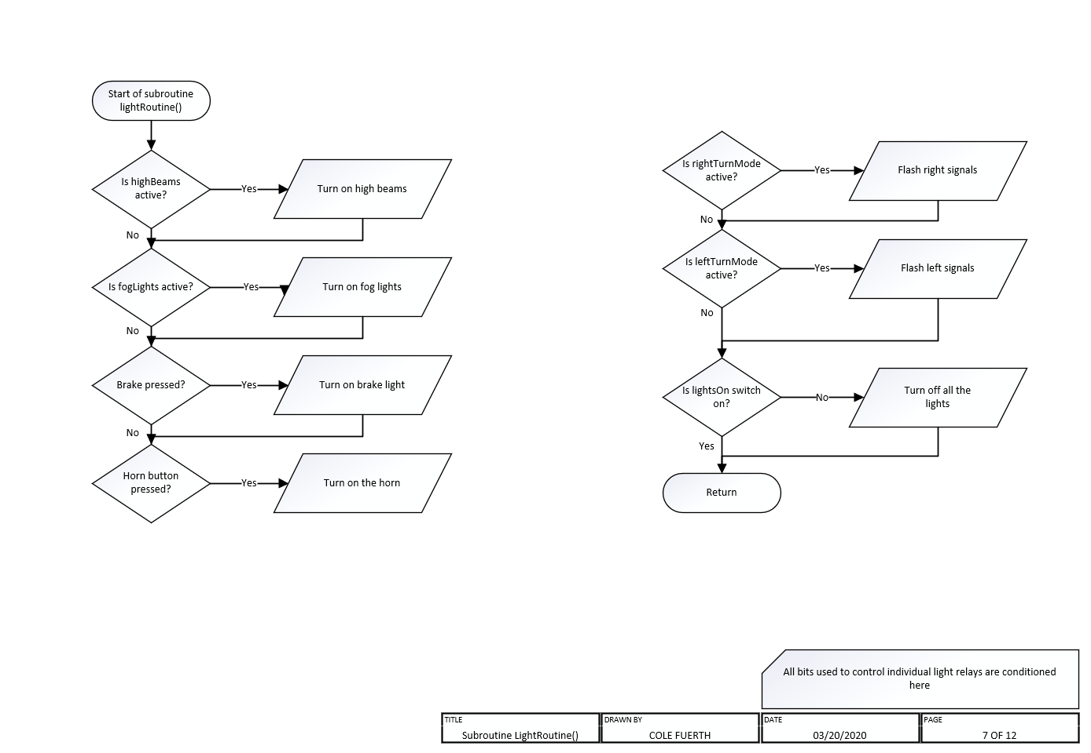

Slide 38
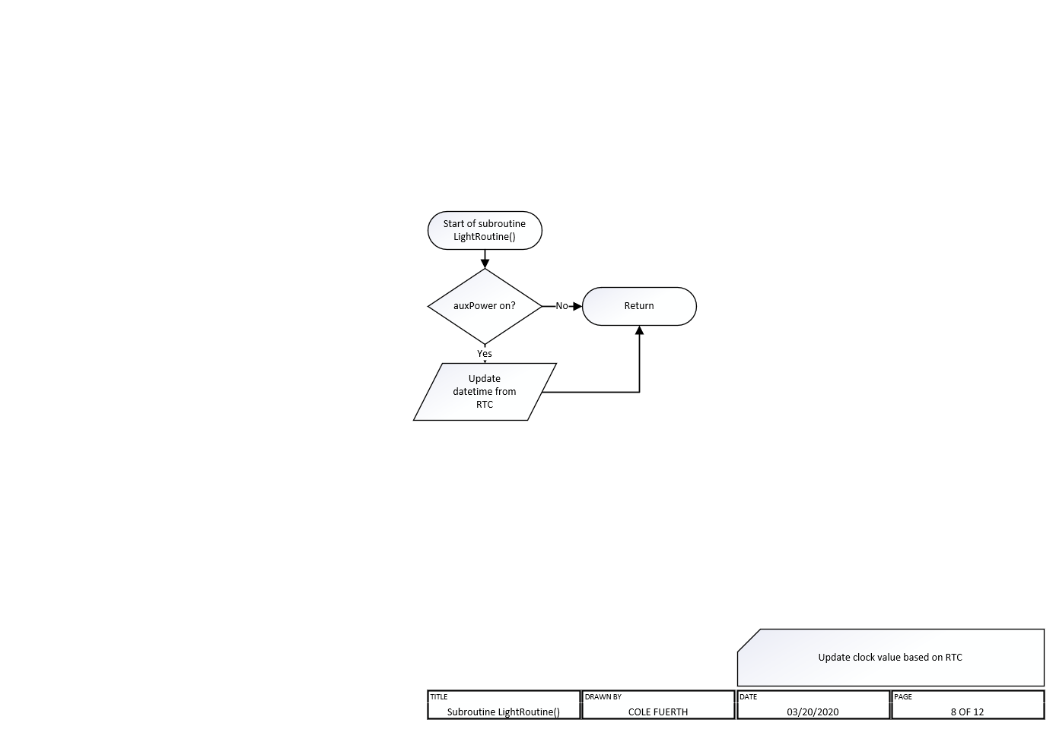

Slide 39
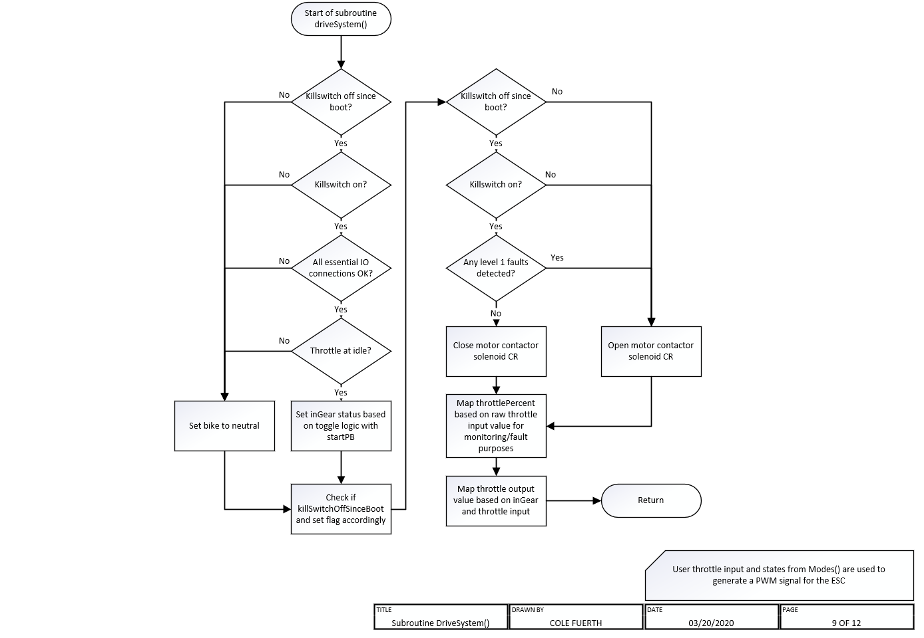

Slide 40
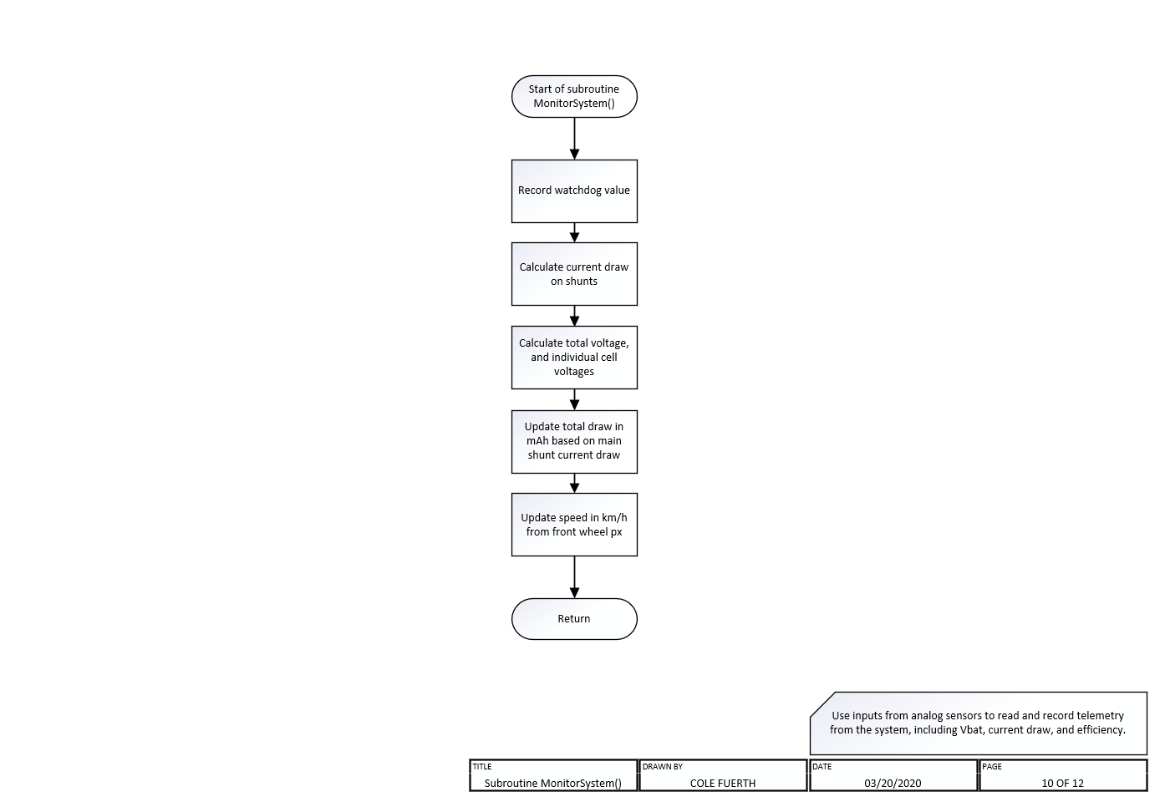

Slide 41
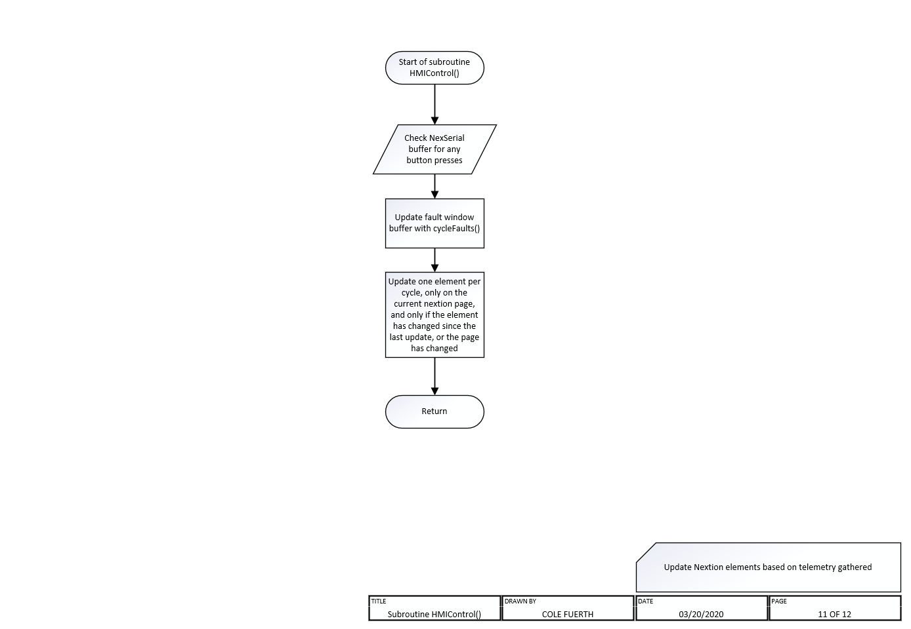

Slide 42
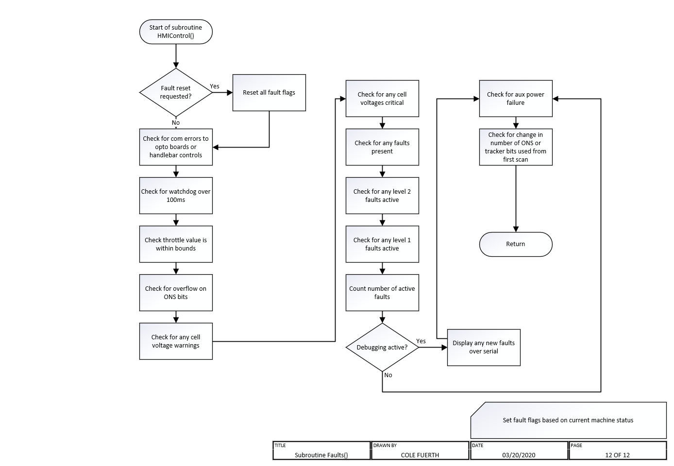

Slide 43
MECHANICAL DESIGN
No mechanical design was done before build, parts were only drawn after assembly
Assembly was headed up by Scott MacKay, a precision machinist and an enthusiast for anything with two wheels, who gave me the idea for this project. He shaped and built the panels and fender to the frame, and made everything fit to what I wanted. Scott was around for 80% or so of the mechanical build, through January and most of February

Slide 44
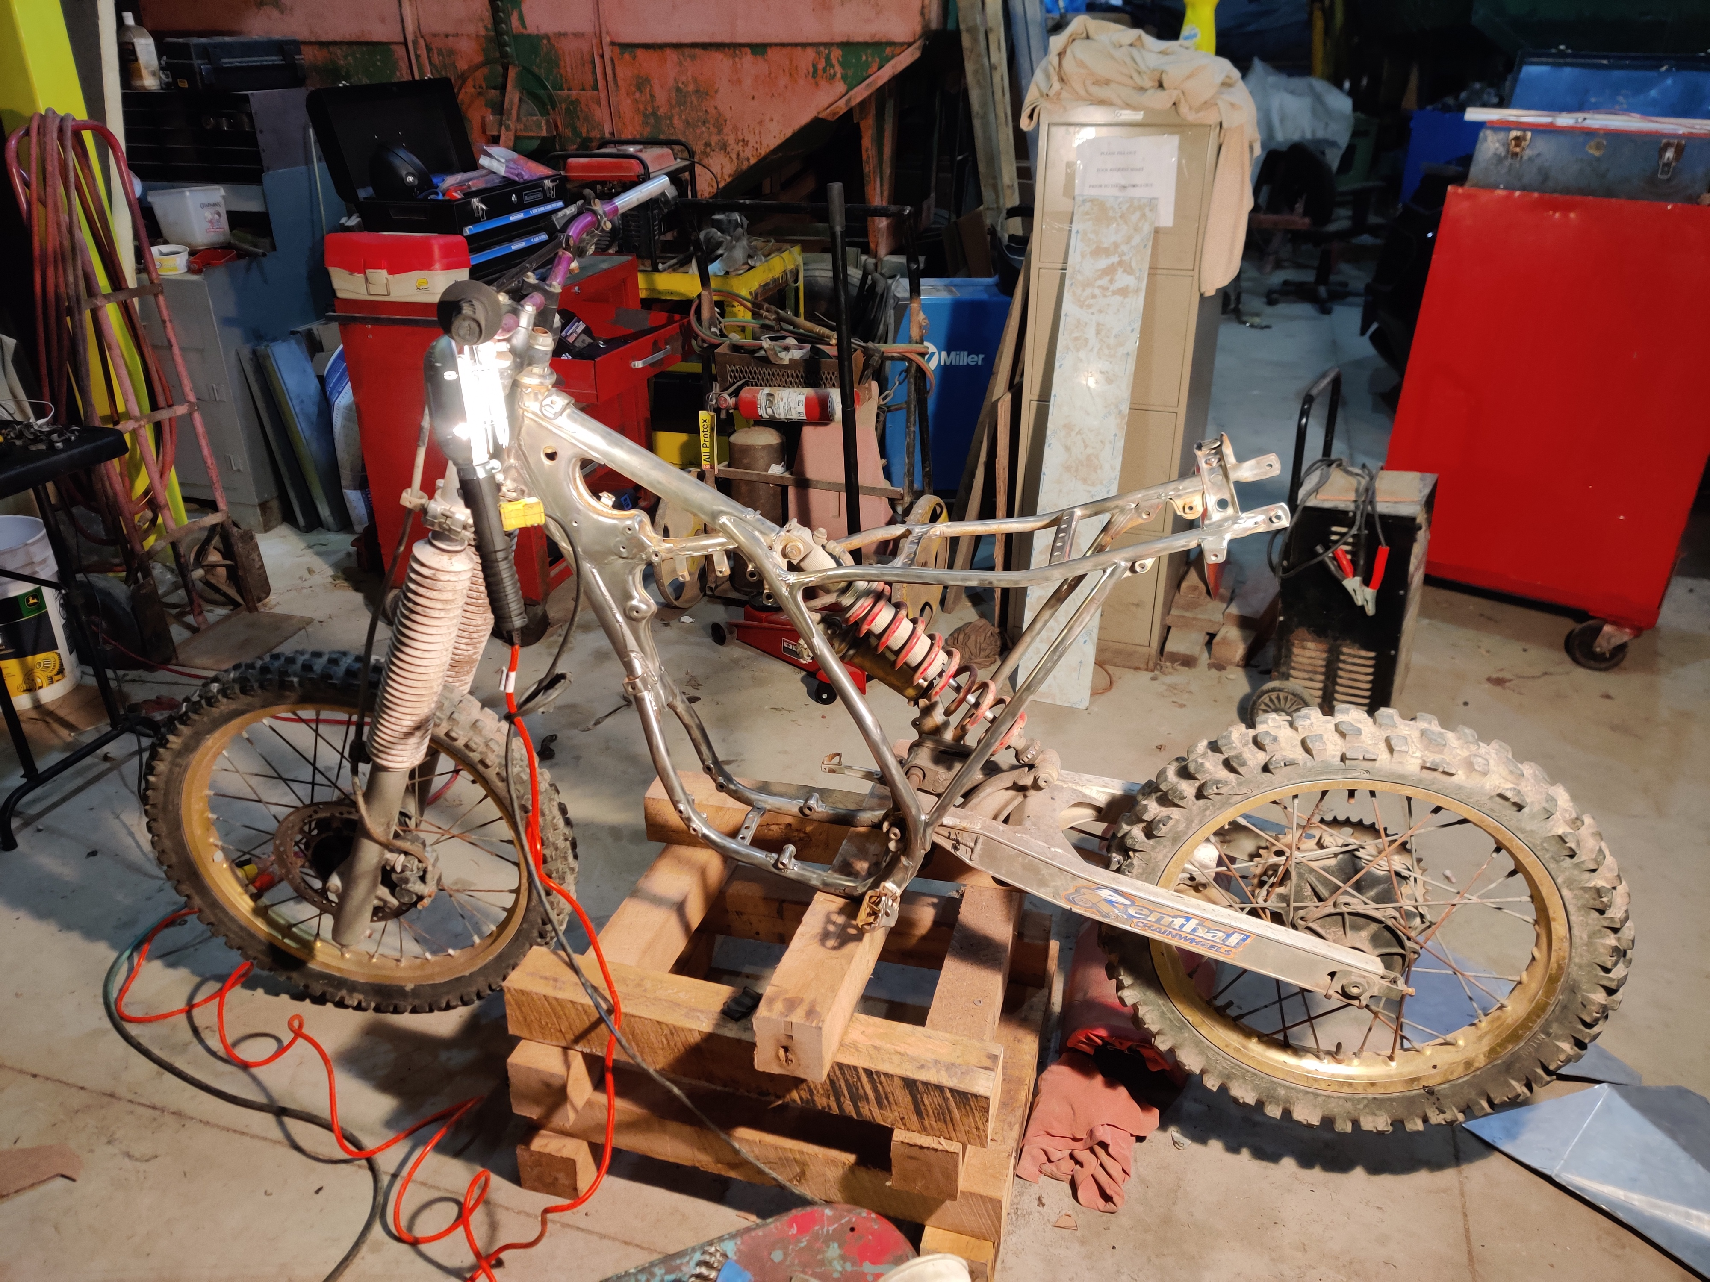
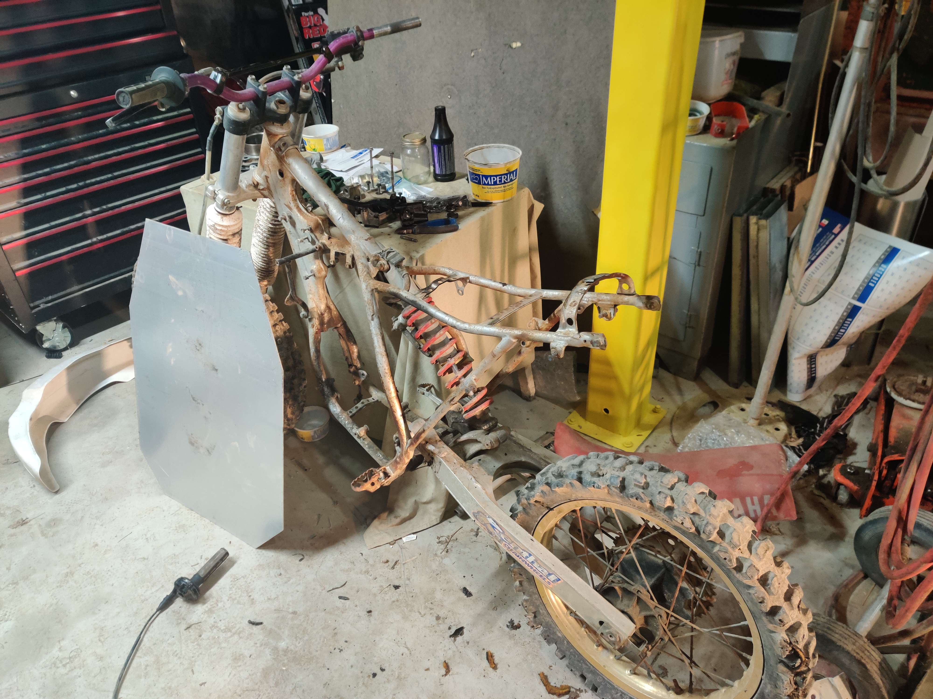
Mechanical design
First, the frame was stripped and wire wheeled in preparation for the build
Before
After

Slide 45
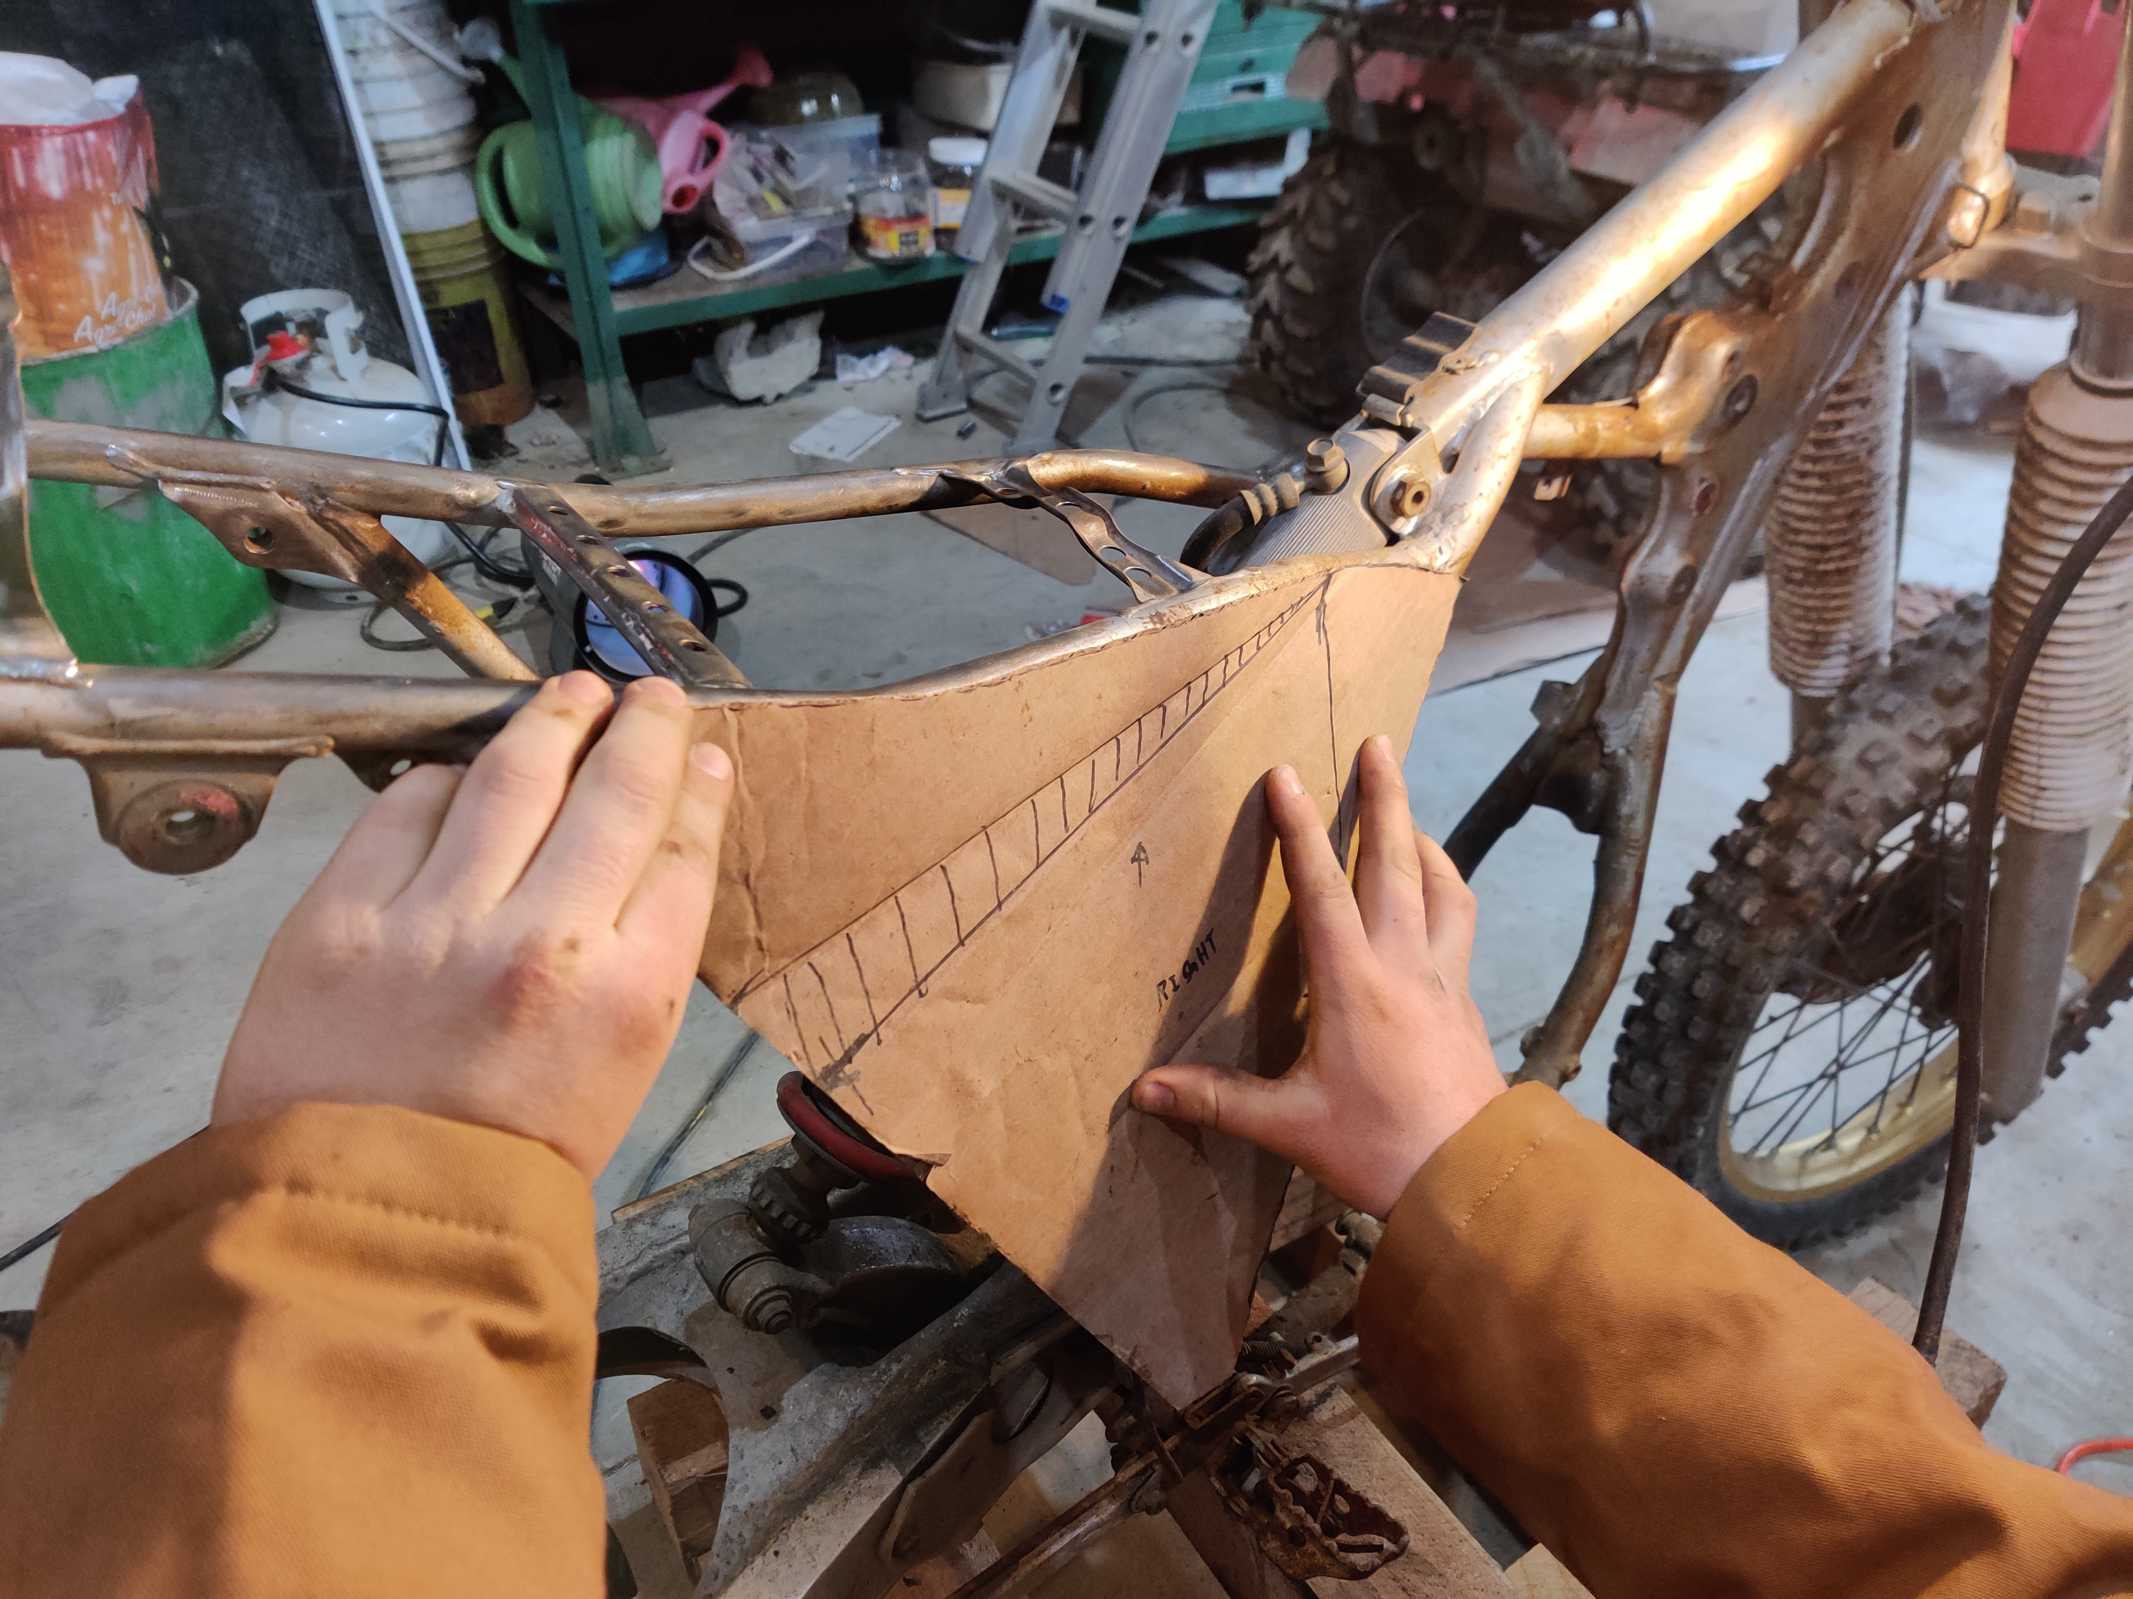
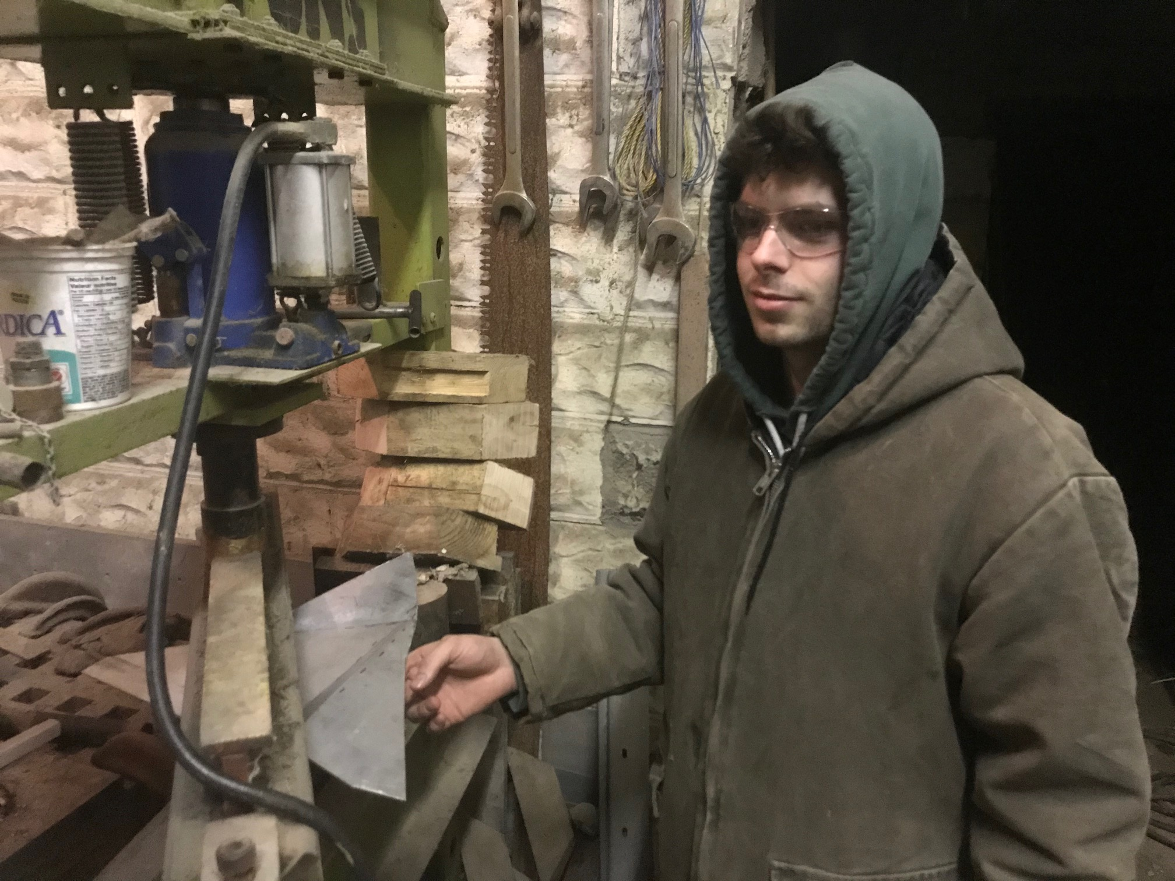
Mechanical design
Next, cardboard cut-outs were used to trace the lines of the frame, to determine where to cut and fold sheets of aluminum to make up the frame

Slide 46
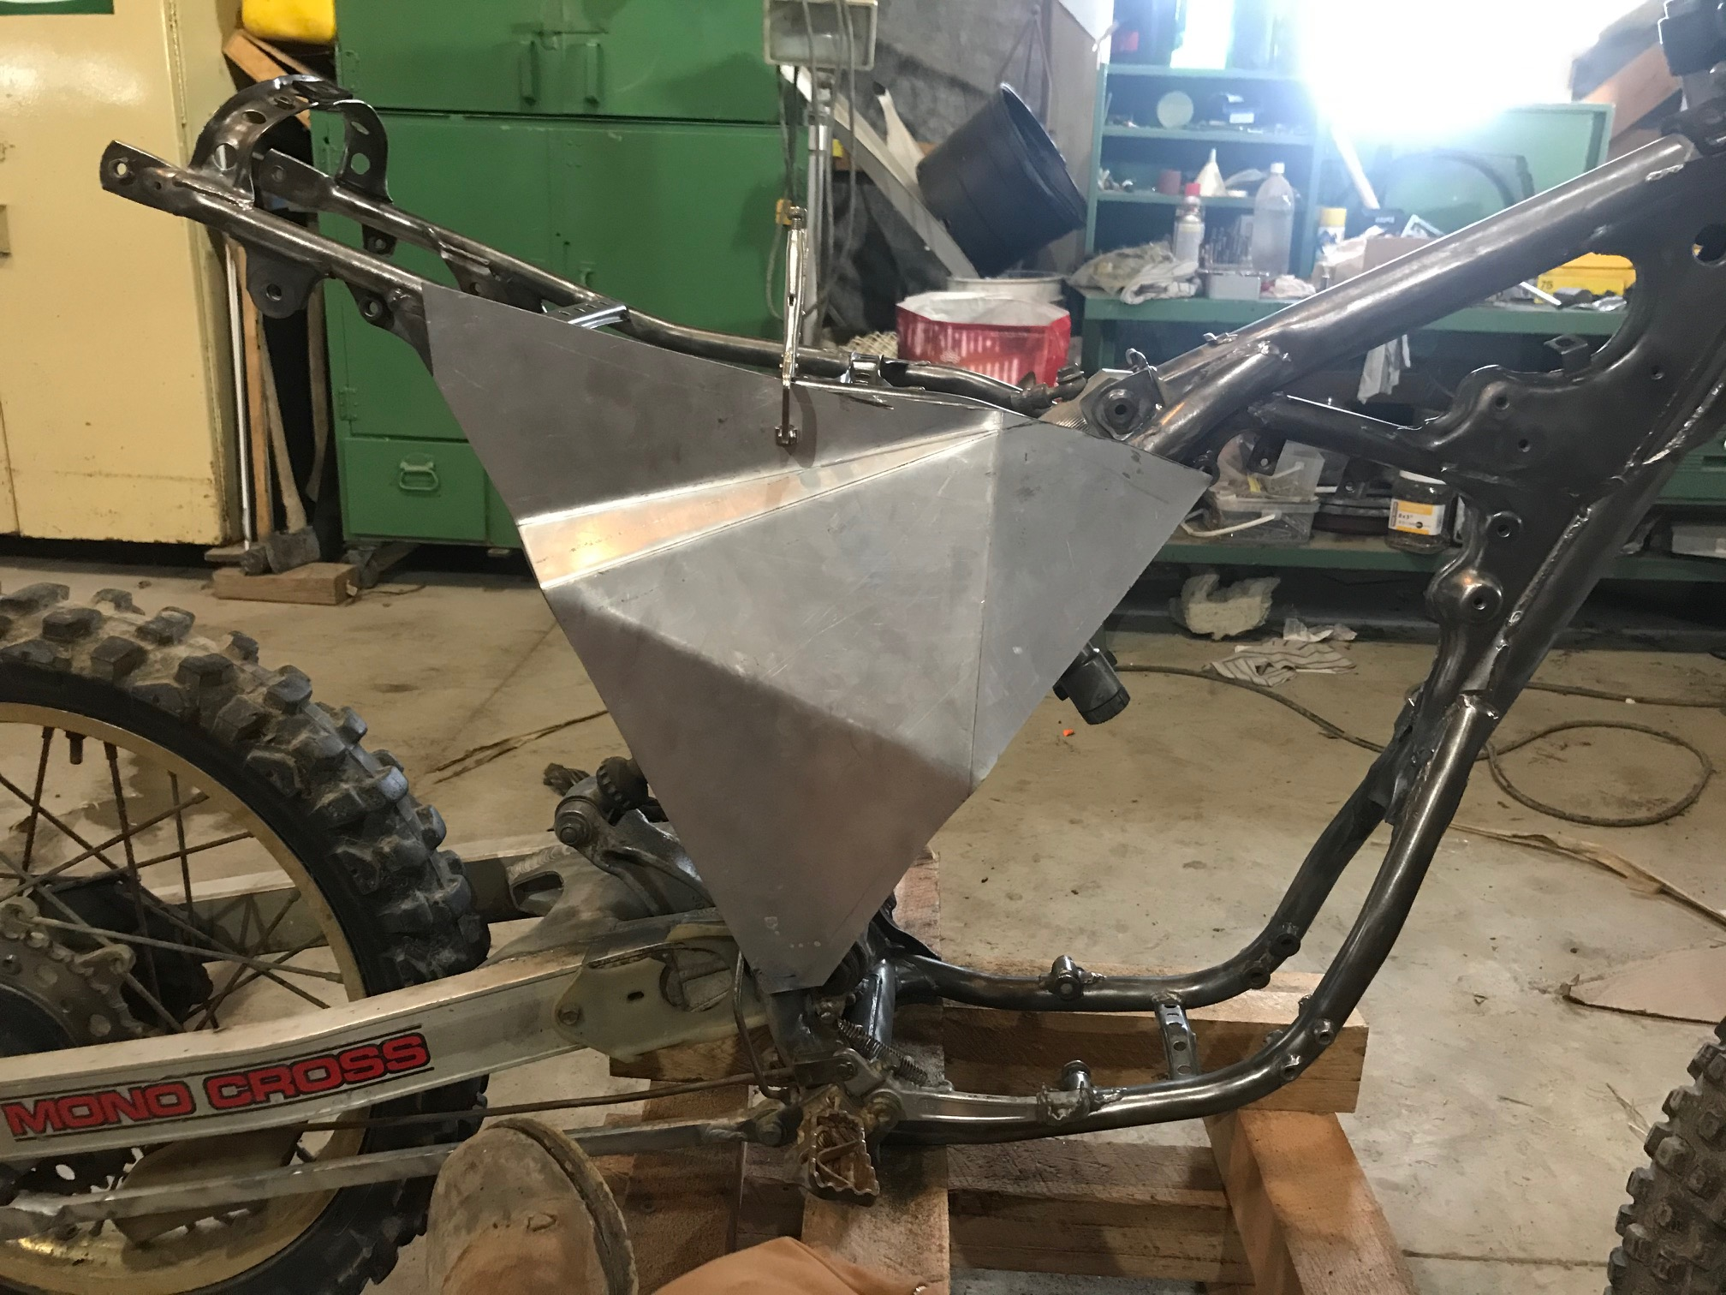
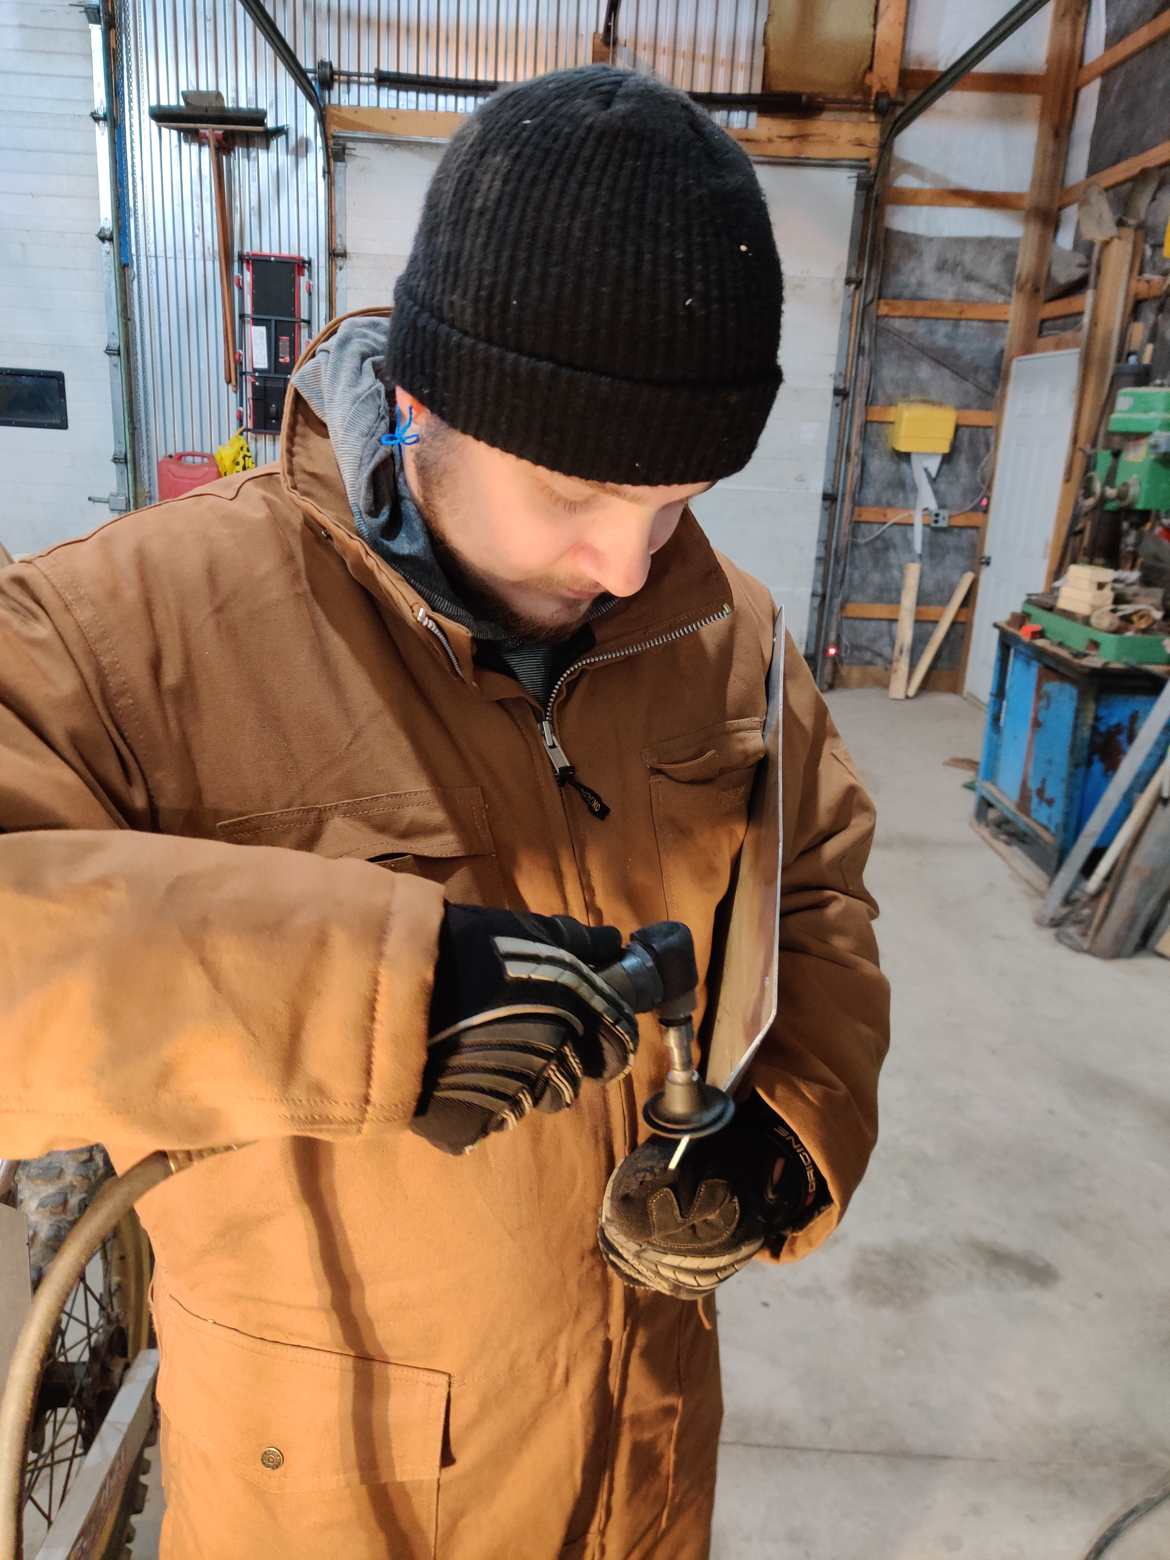
Mechanical design
Panels were dry-fitted and bent to fit the lines of the frame

Slide 47
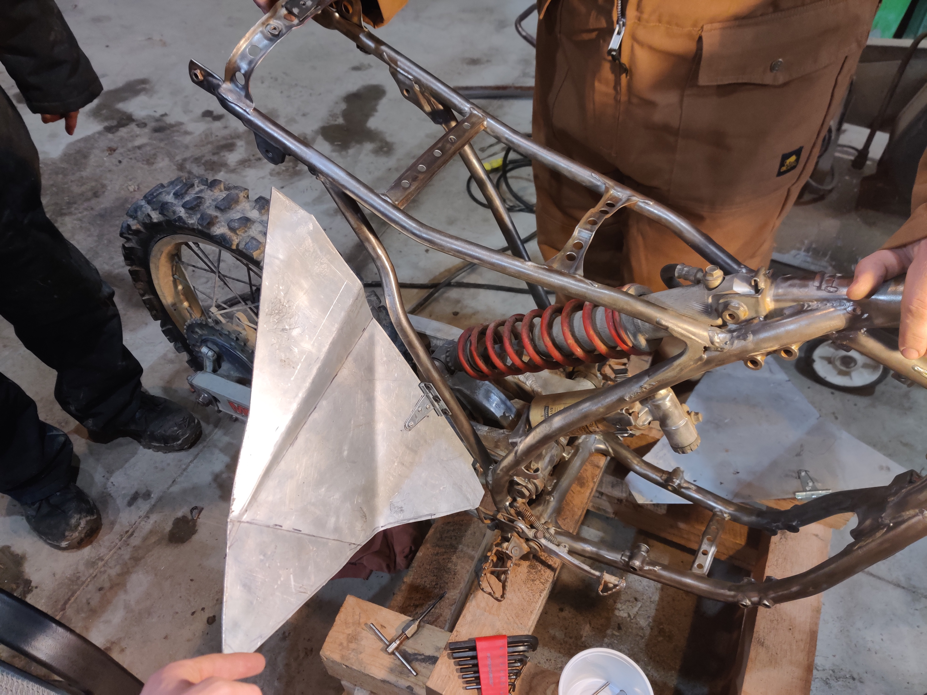
Mechanical design
Panels were mounted with hinges

Slide 48
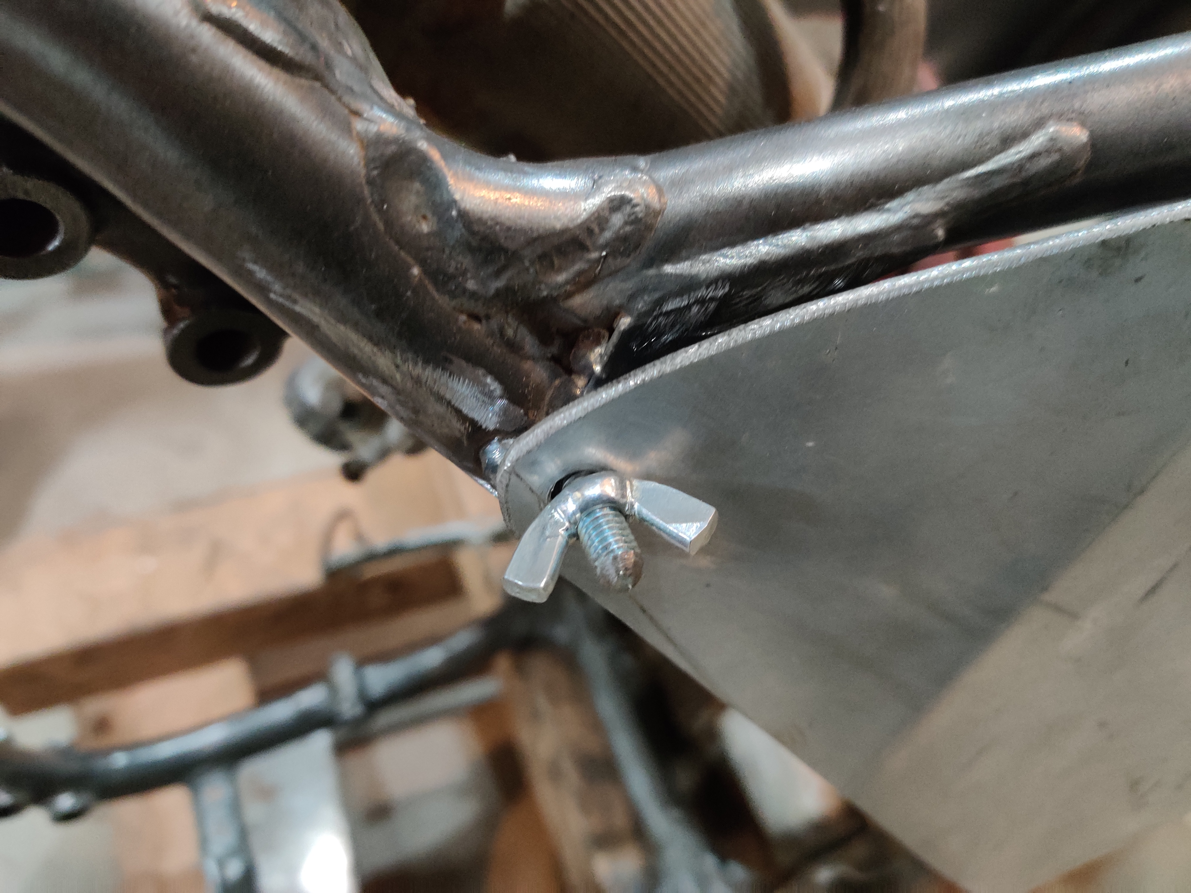
Mechanical design
Panels are secured in place using 6mm bungs welded to the frame, and wing nuts

Slide 49
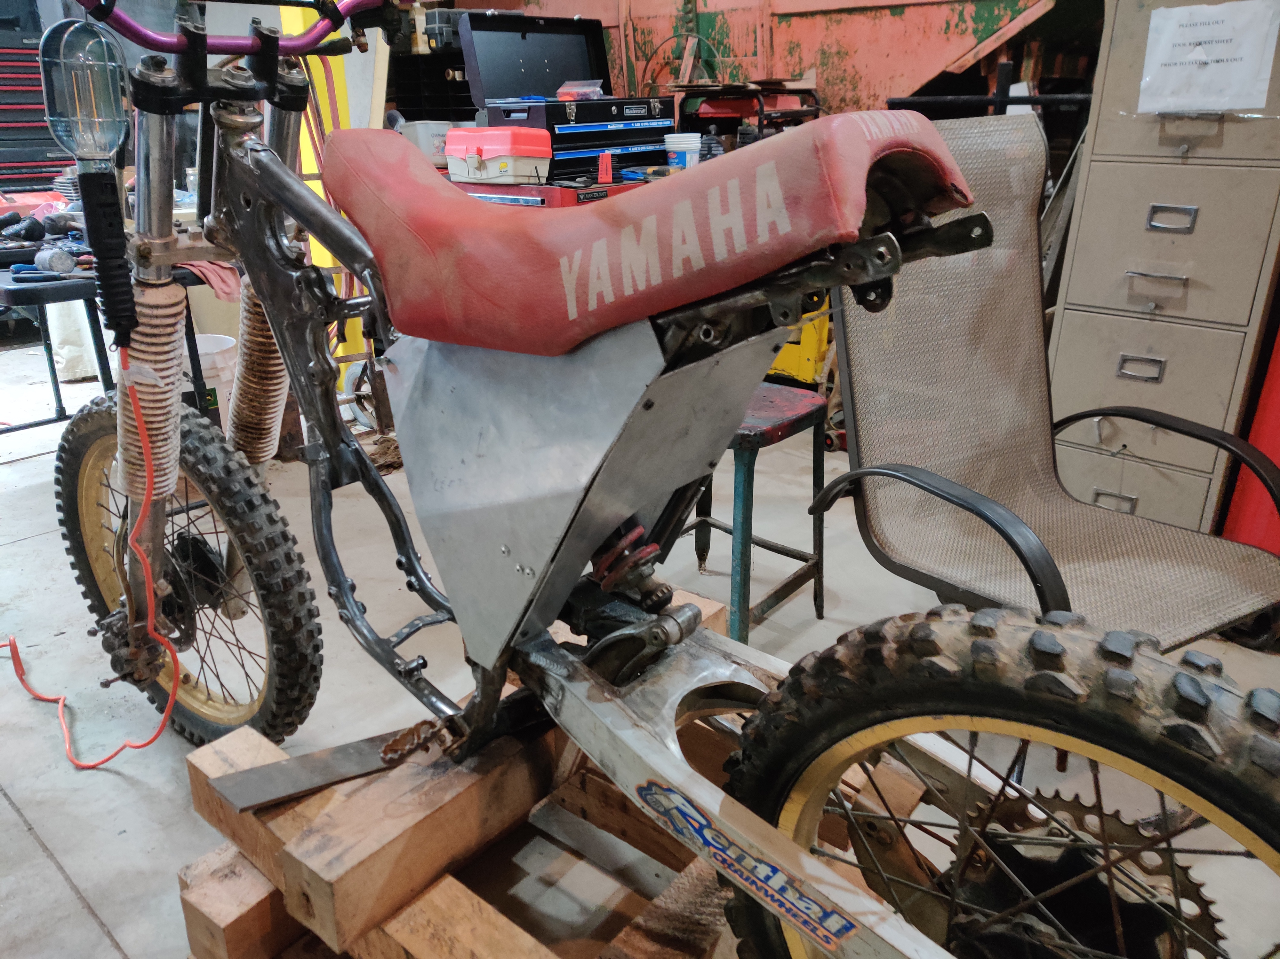
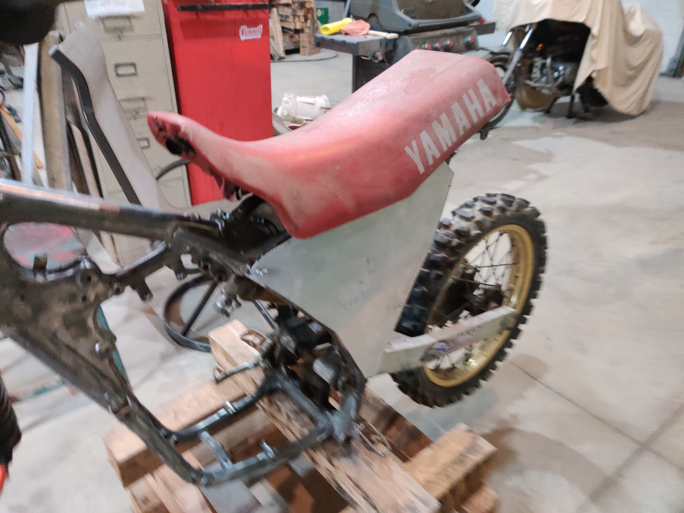
Mechanical design

Slide 50
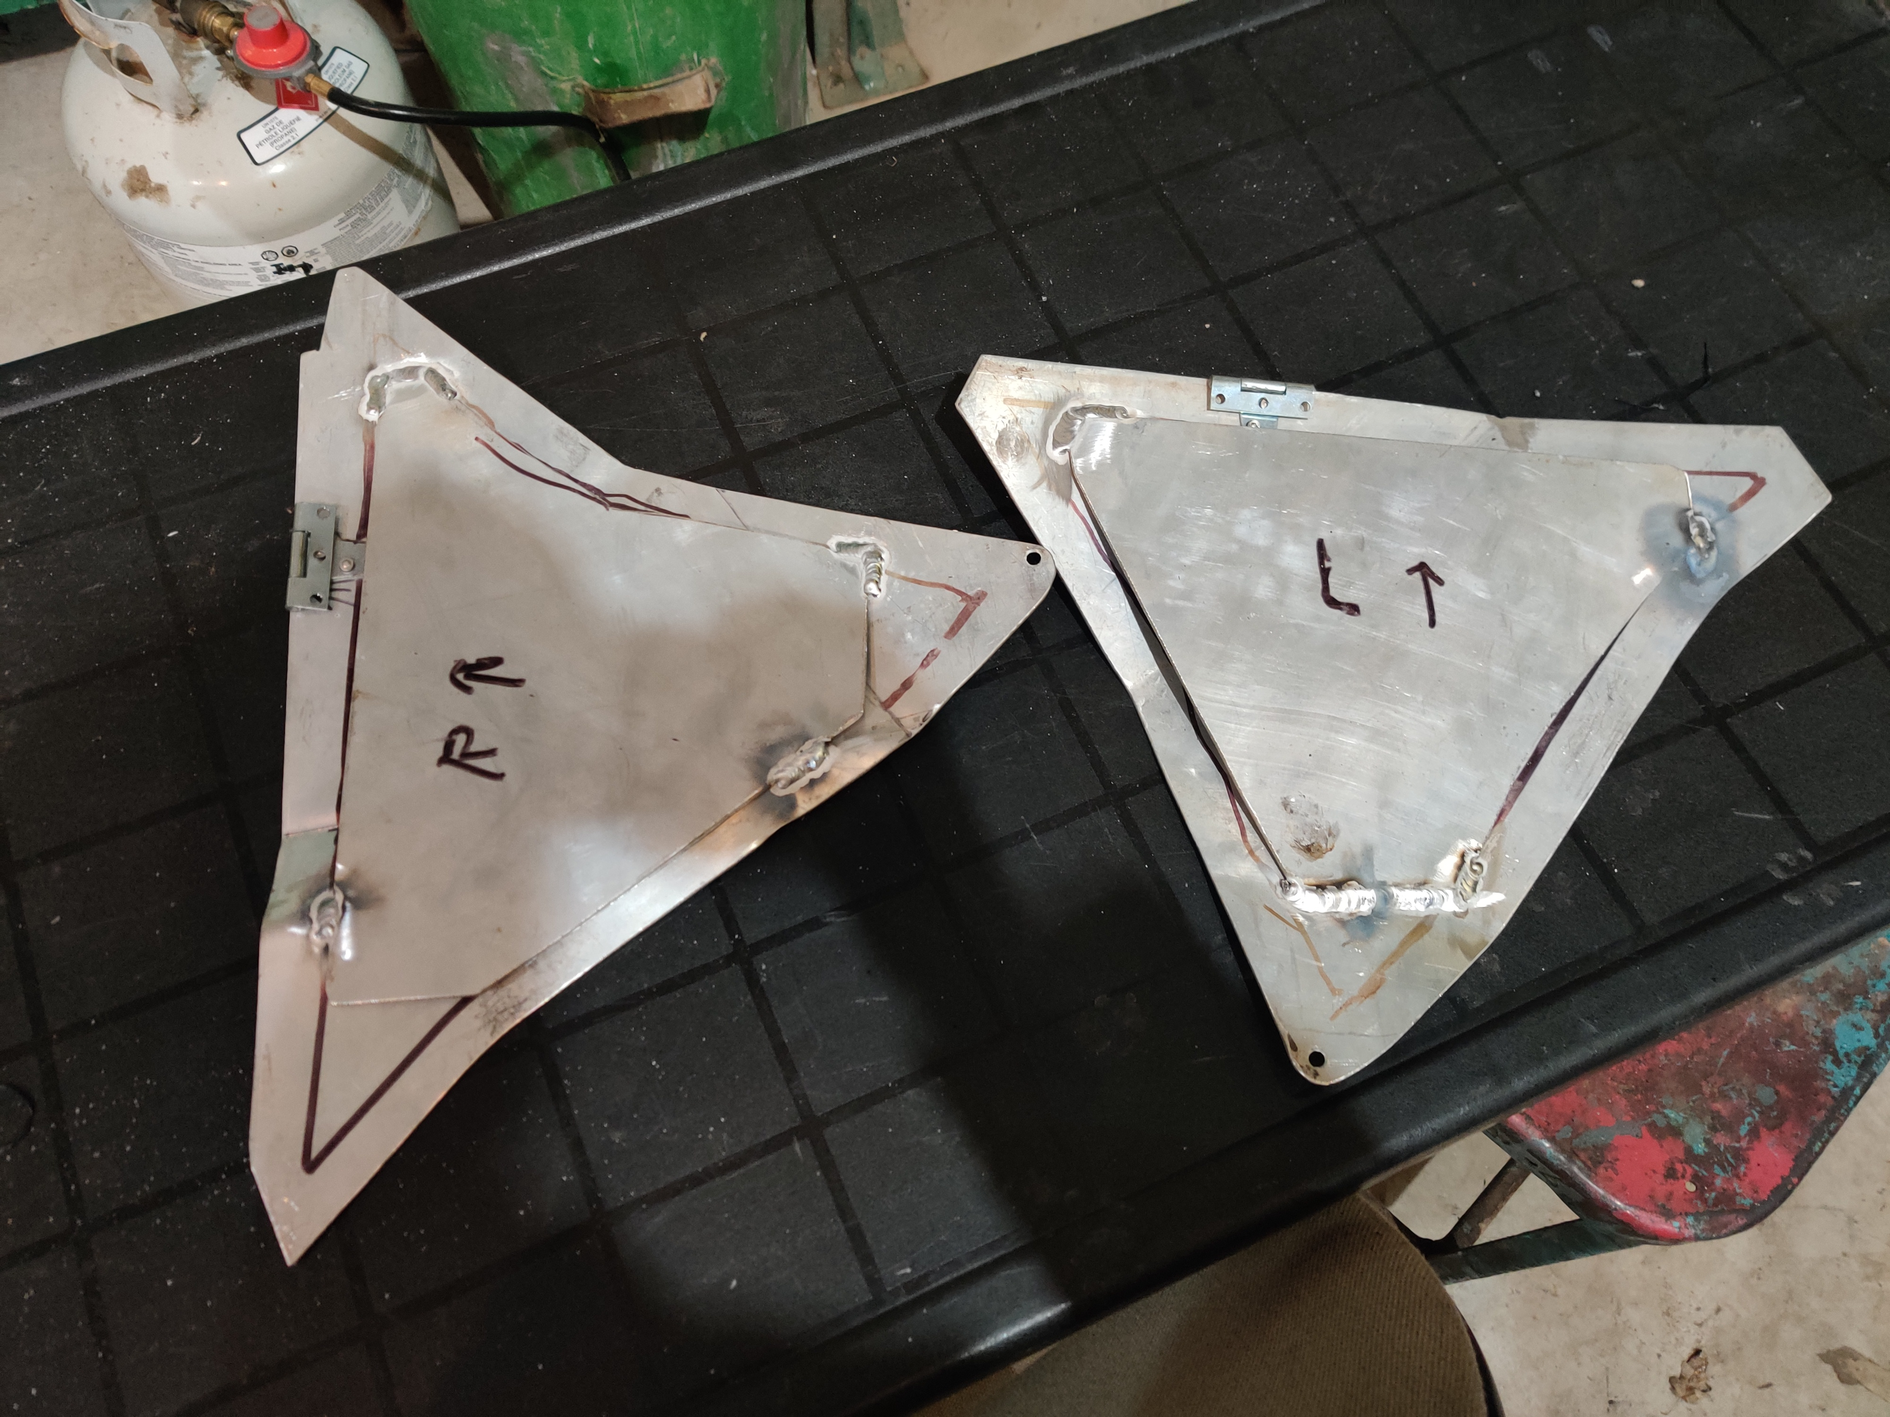
Mechanical design
An aluminum backplane was welded inside the line of the frame on the panel, so that there would be a flat mounting surface for electronics
Welding was done by Allen Repmann, a family friend who comes riding with Scott and myself occasionally

Slide 51
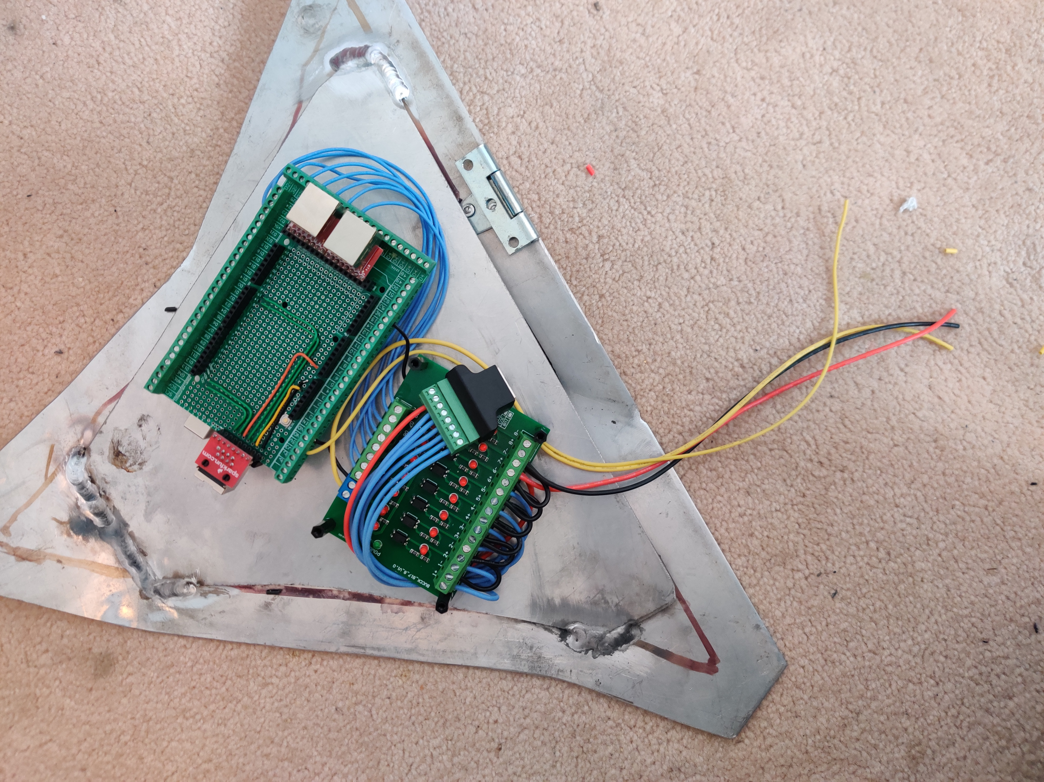
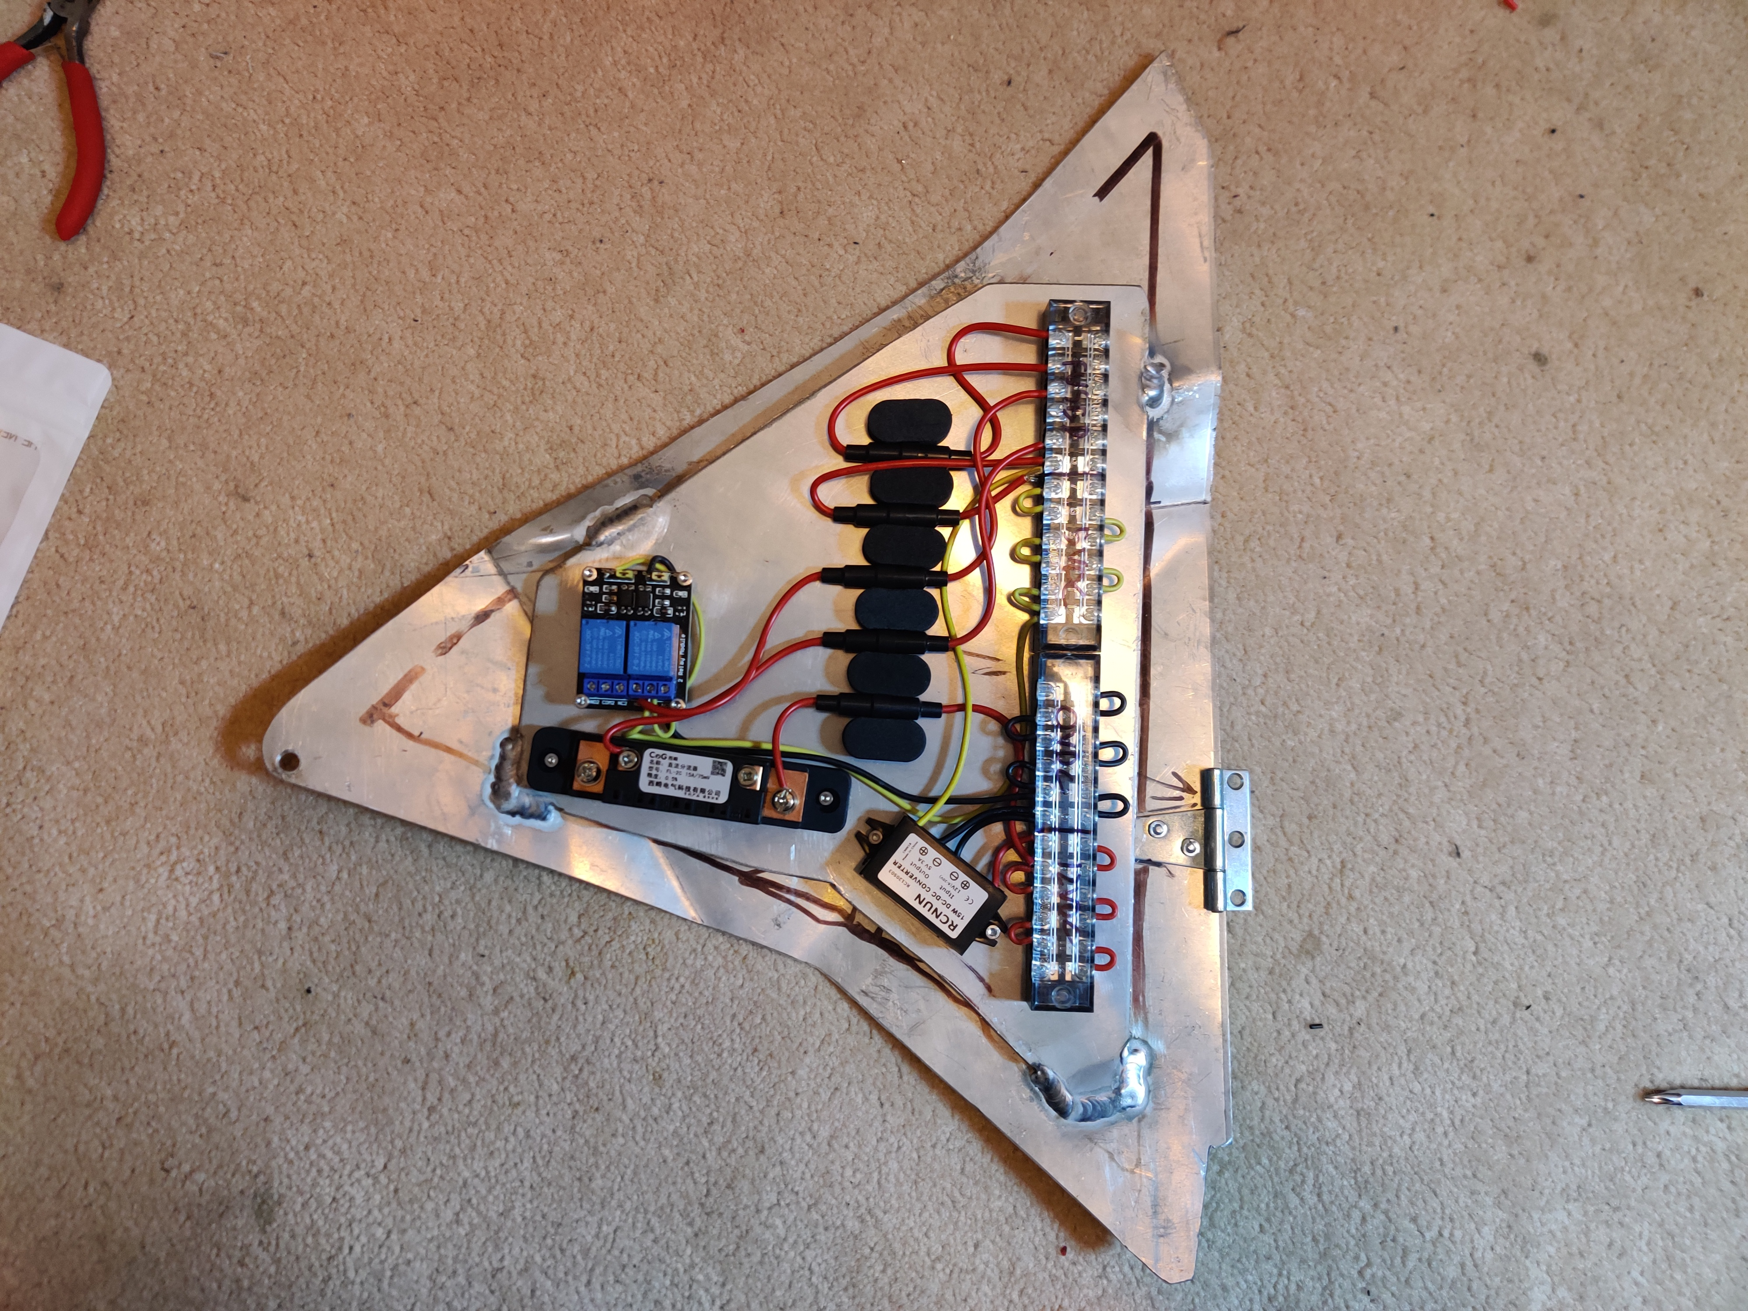
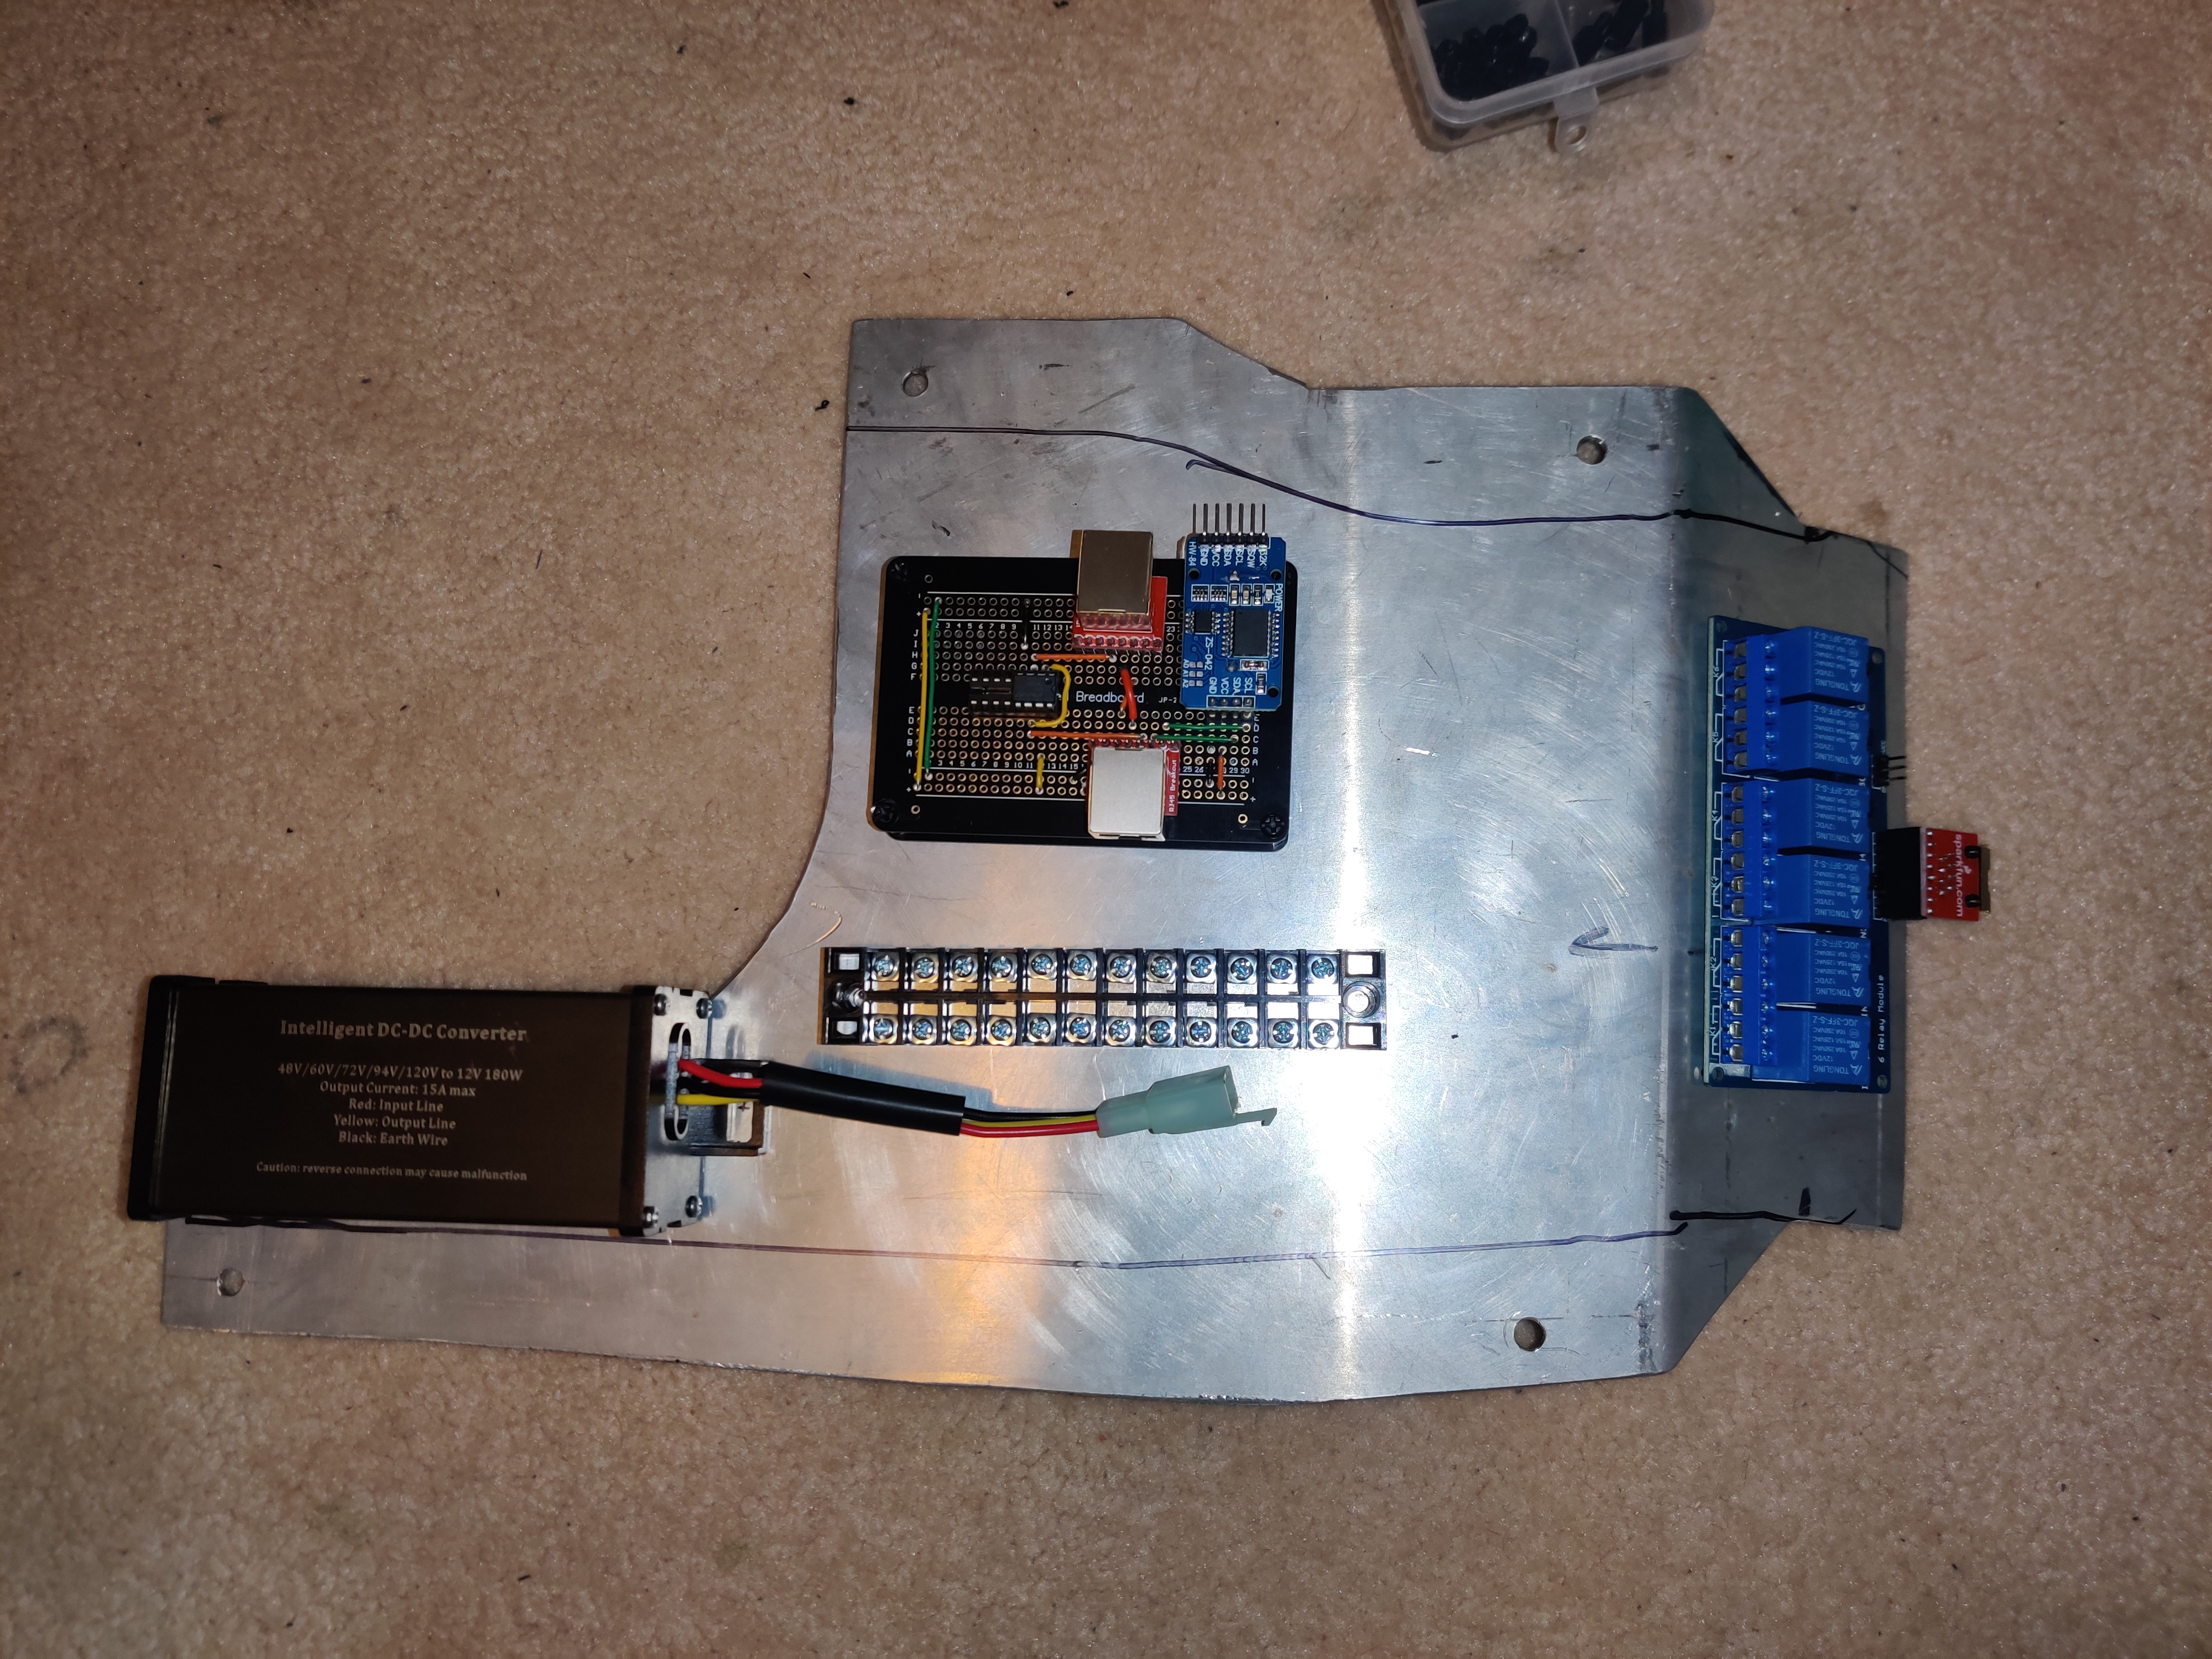
Mechanical design
Panels were drilled and tapped, so that components could be mounted directly to the aluminum backplane

Slide 52
Mechanical design
The rear fender was bent and welded to come apart in sections
The first section houses the relay pack, and is the medium between the lights on the fender, and the rest of the vehicle. This section also serves as the mounting bracket for the rear section
The rear section slots onto the middle section, and is secured with M6 screws. It is designed such that, it is easy to remove for maintenance, while being strong enough to support the entire weight of the bike on the end of the fender

Slide 53
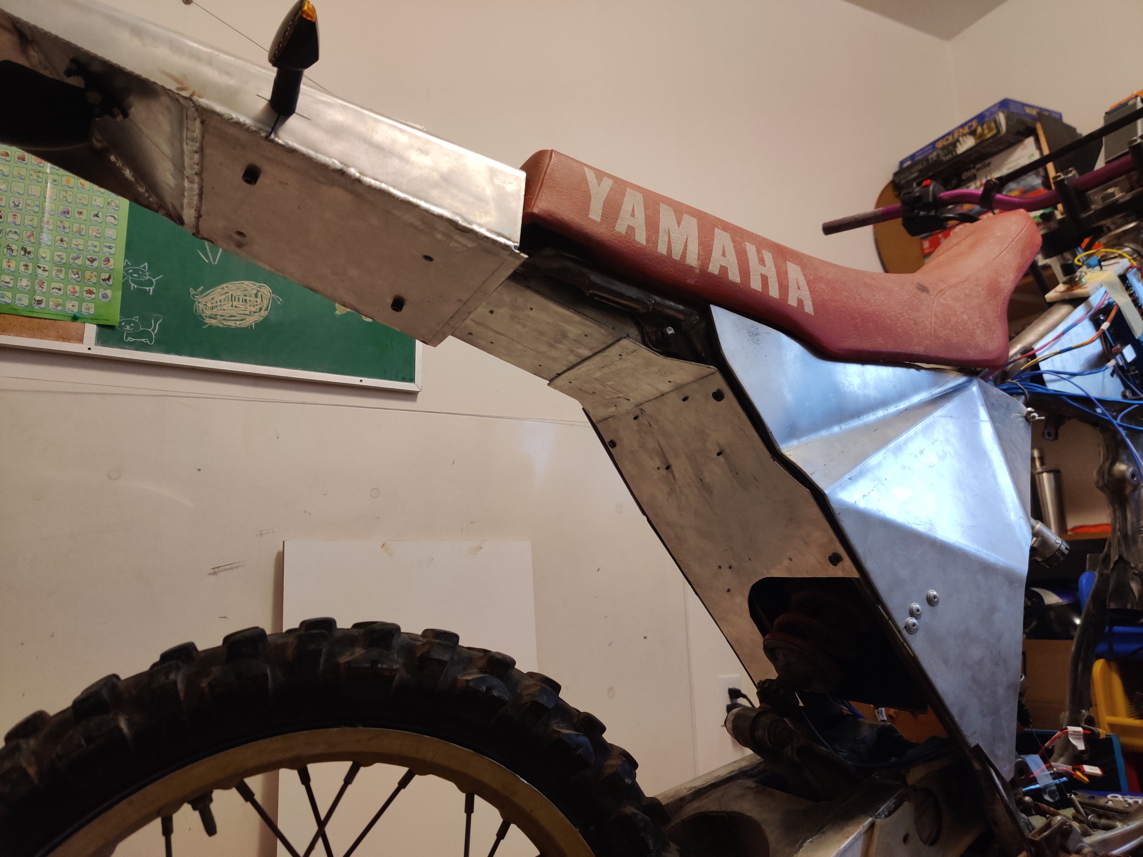
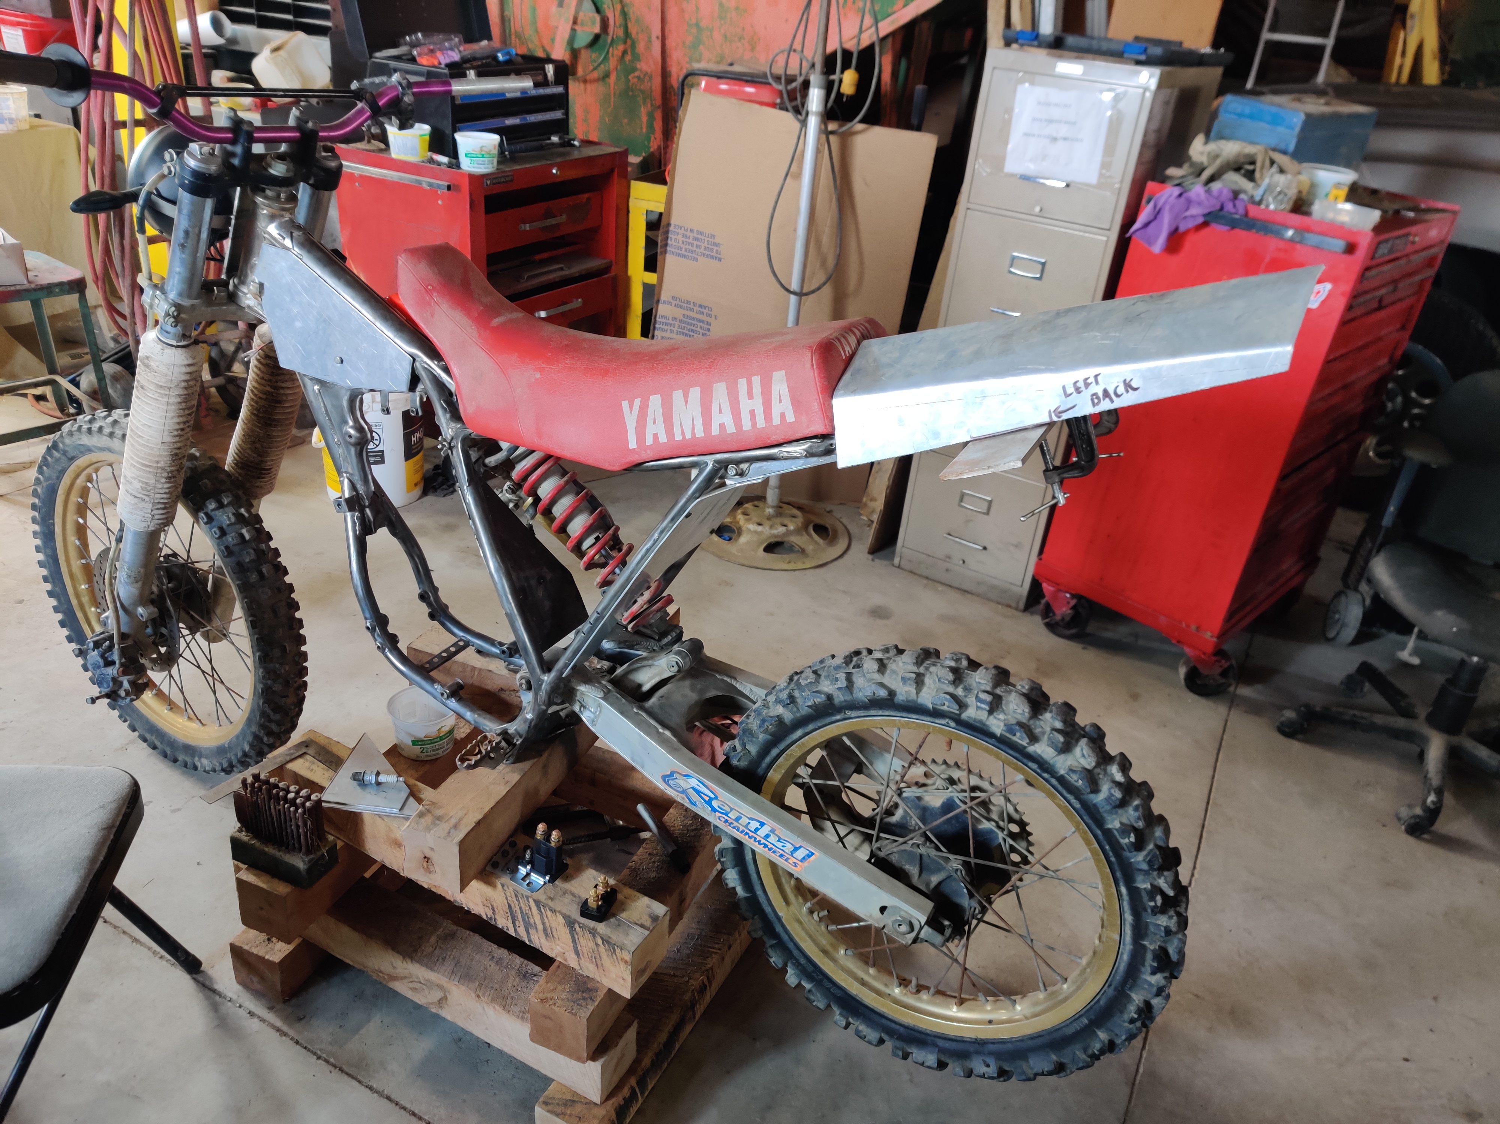
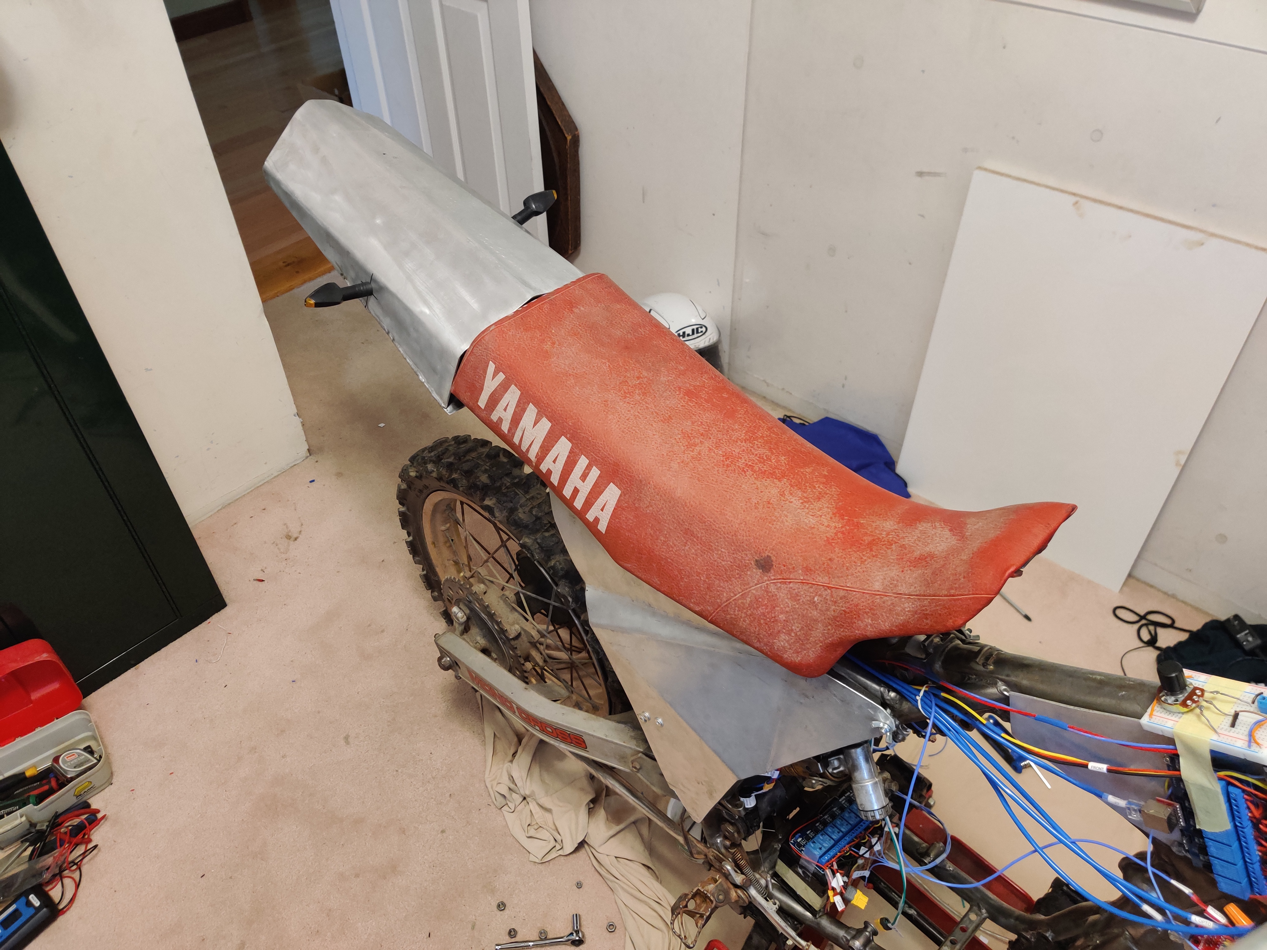
Mechanical design

Slide 54
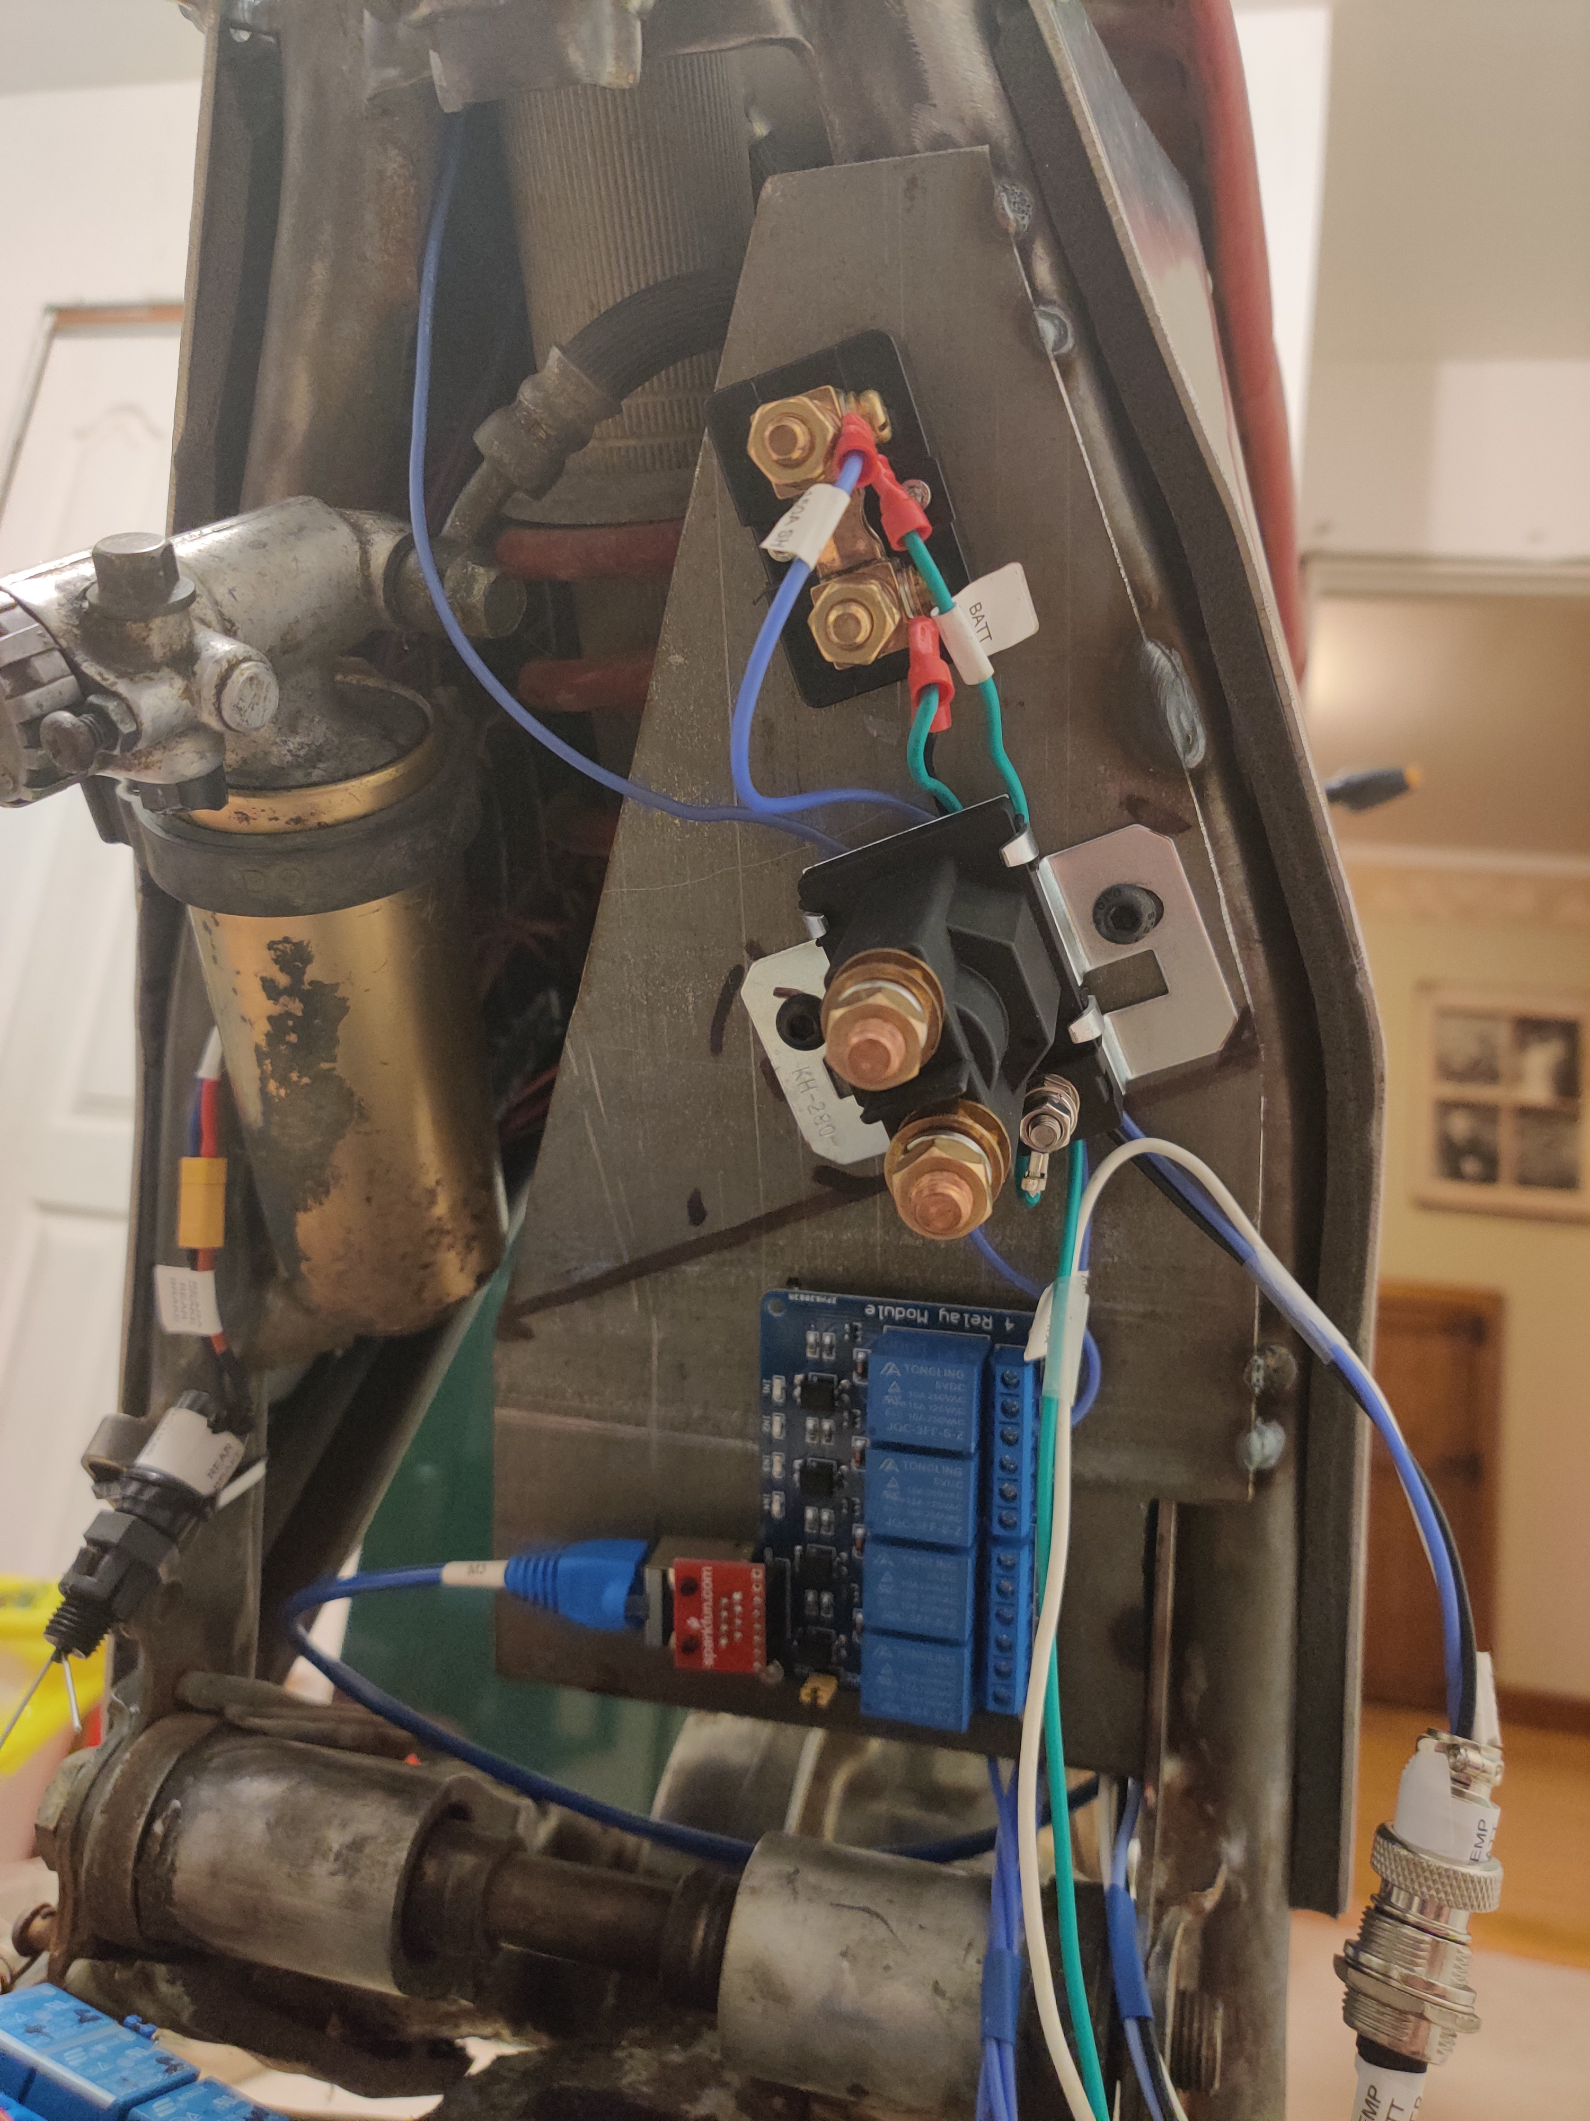
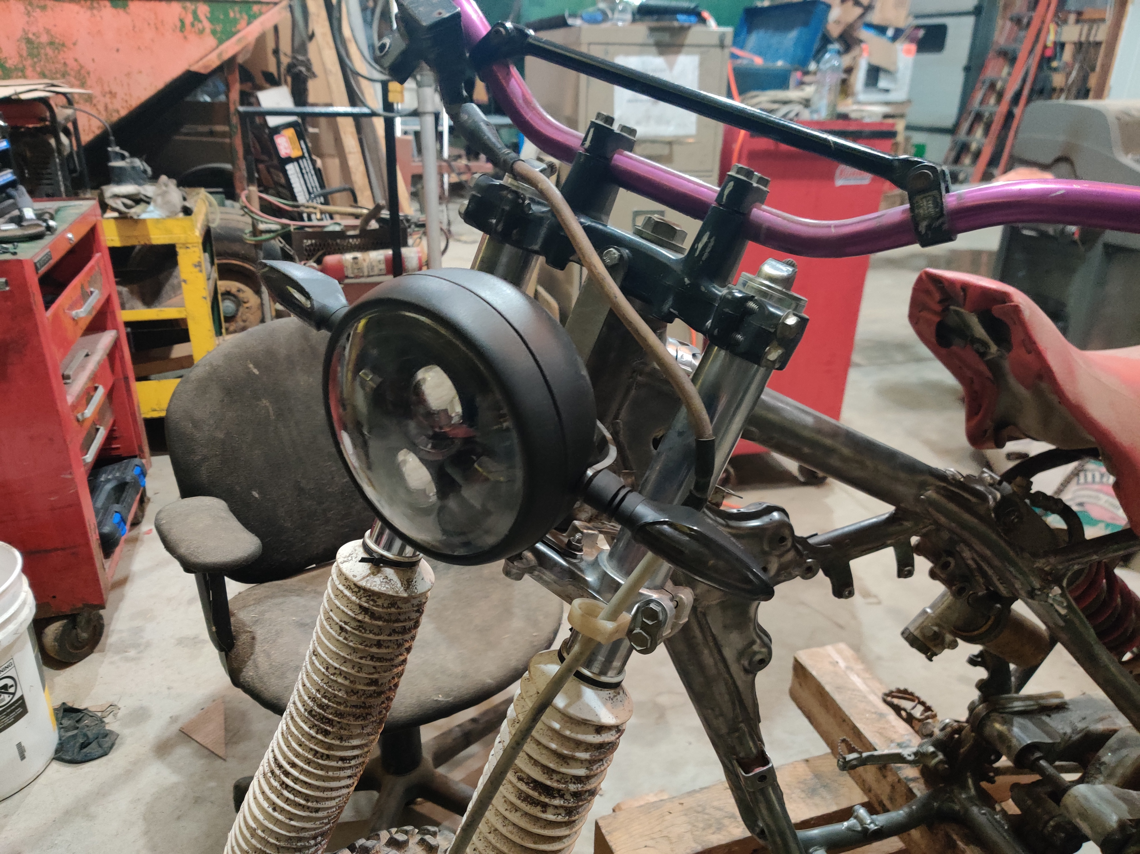
Mechanical design
Other additions include the mounts for the headlight and turn signals, and the center panel for the interface to the EV Controller

Slide 55
Mechanical design
The motor and ESC were chosen based on the specs of the KTM E-XC. The power and top speed of the KTM were used to calculate the motor kV and power. A controller was ordered accordingly, and batteries were bought and matched to the KTM spec.
There are no pictures of the motor or controller because of shipping complications. I do not yet have the motor, controller, or throttle from the supplier.

Slide 56
Program design
The program was designed over the course of 7 months, constantly changing over time
There was a main ‘standard’ program that contained tested code that could be used in the final program, and many smaller programs for testing individual components
Every couple months, a new standard would be developed, based around optimizing and cleaning the code of the previous standard

Slide 57
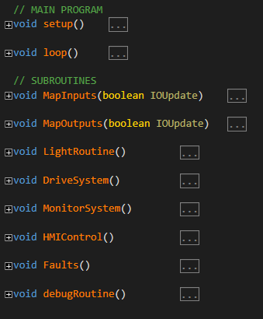
Program design
The result of different standards, for both hardware and software, was a final product that is clean and optimized for its application.

Slide 58
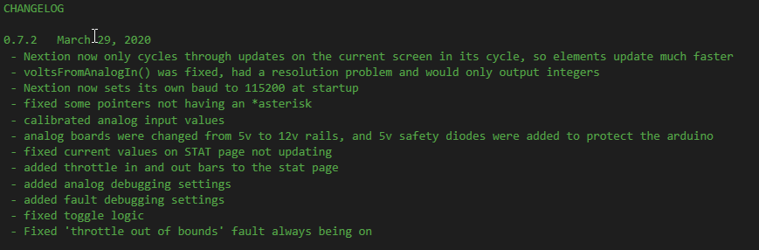

Program design
The final product is far from perfect, but will continue to be developed
As of March 30, 2020, the main program is just over 1600 lines long.

Slide 59
Program design
The main program consists of a setup() method, a main loop(), and 8 subroutines that are cycled through each processor scan.
On top of this, there are 16 HMI button methods called on button presses
There are also 24 methods that are called throughout each scan that serve different functions, from updating the serial out buffer and reading the serial in buffer, to analog conversions, timers, one-shots, flasher bits, toggles, limits, HMI functions, and more.

Slide 60

Program design
Memory management is done using pointers and arrays
Arrays contain the memory for the inputs and outputs, and pointers point to the memory addresses in the array, allowing reading and writing of individual elements in the array

Slide 61

Program design
Faults, similarly to IO, are also handled with pointers and an array
Each fault is coupled with a level and a message
A level 1 fault is a ‘critical’ fault, and will pull the safety contactor

Slide 62

Program design
To make debugging easier, as I approached each system, I made debug messages to feed back what is happening within the program, and these messages can be toggled on and off using bits in the firmware, as they are needed.

Slide 63
Program design
The safety system used to manage power to the motor controller is a 200A solenoid contactor.
The kill switch on the right handlebar is in series with a relay and the solenoid coil, so either the processor, or the user can open the contactor at any time.
The contactor can only close if:
The kill switch has been off at least once since boot
The kill switch has been off since the last level 1 fault
There are no level 1 faults active
The kill switch is closed

Slide 64

Program design
Arduino IO is updated at 50Hz
Every scan, throttle input and output are updated
Since analog inputs take a while to process, only one analog monitoring pin is updated per IO update, cycling through one each time.
The speed PX pin is updated every scan, regardless of the 50Hz update rate of the remaining IO

Slide 65

Program design
The MonitorSystem() routine looks at data collected on the Arduino inputs, and processes it into useful analog readings.
Current shunts, voltage buffers, and total current draw are analog values handled here using map() methods
Speed is calculated by counting the number of times the speed PX goes from off to on in half a second, and then using that number to calculate the speed

Slide 66
Program design
Check for update?
Page
Buffer
Element ID
Value
Max # of characters
Because the Nextion stock libraries would make the Arduino hang, I looked at the code and made my own logic based on the serial logic that Nextion had, but optimized it for my application, for speed and efficiency
Constantly changing elements are only updated one at a time on a 25Hz pulse, cycling through all elements on the current page. Some elements, like indicators that only change occasionally, are checked for updates every pulse.
All Nextion outputs are buffered with a String array, so elements only update on a page change, or when a value change is detected.

Slide 67




Hmi design

Slide 68
Problems experienced
Getting batteries capable of powering a system like this one was troublesome
Shipping restrictions from china prevented cells over 100Wh from being shipped by air, and some stores would not ship by sea either
Lithium from America is very expensive
I got lucky, and got about 2.6kWh of batteries from a man in Toronto, for $200. They also have self-balancing circuits, so charging is immensely easier

Slide 69
Problems experienced
Charging all the cells at once is a big issue, without needing to remove all the packs from the vehicle and rearrange them from series, into a parallel configuration.
This was solved by making 16S packs of 4S cells, using an 8-channel relay
Each cell got one relay contact per lead, and the NC contacts were wired in series, but the NO contacts were in parallel.
This meant, when the relay was wired up and given a 5V supply, the batteries would disconnect from the series wiring and switch to a 4S parallel charging circuit, where I can plug a lead on the front of the vehicle into a high-output lithium ion charger

Slide 70
Problems experienced
The day after Progress Report submittal, I discovered the reason I was having intermittent analog issues was, although the CA3140 Op-Amps I was using were rated for single-ended use, they would only output up to 2.85V on a 5V positive rail.
This was solved by providing the analog stack with a positive rail of 12V. \
Limiting output to the Arduino to 5V was achieved using a 5V rail as reference, with 1N4005 diodes biased such that, if any output should be greater than 5.7V, the diode would sink the remaining current to pull down the voltage

Slide 71
Problems experienced
The motor, controller, and throttle assemblies are still not here
Email communications have been consistent since the beginning of October 2019
Motor was ordered in November, controller was ordered Mid-January, because the controller I wanted was “a week away” from release, and they told me it would be out by January at the latest. As of mid January, I decided I could wait no longer. They told me the controller would be 4-6 weeks until delivery.
Emails starting February 10, and every week following, had the supplier saying “shipping Monday for sure!” up until the pandemic closed everything down.
This problem was temporarily solved using a drone motor and controller, and a potentiometer on a breadboard for demonstration.

Slide 72
Problems experienced
Rear relay pack, upon powering, does not activate relay coils
LEDs on the board indicate signal is being received, and aux power is being applied to the board where it should be. A multimeter showed that there was 5V being applied to the relay coil when it should be applied, but the coil does not energize.
This issue was not fixed for presentation, as I did not have any relay boards on hand, and did not anticipate the issue, as all debug was done using just the LED indicators on the board.

Slide 73
Problems experienced
Nextion libraries would freeze the Arduino, so research into how serial communications between the Nextion and Arduino allowed me to construct my own methods to send and receive data with the Nextion HMI through serial.

Slide 74
Problems experienced
Nextion serial communications would fill the serial buffer quickly, so methods were made to make use more efficient
One way this was resolved was changing the baud rate from 9600 to 115200
To further optimize transfer, actively changing values are only updated one at a time, cycling through only elements on the current page, at 25Hz intervals.
All Nextion outputs are also buffered, such that an element will only be updated over serial if there has been a change in value since the last update

Slide 75
Problems experienced
Connecting 5V to the Arduino while no 12V power was being applied to the DC-DC step down was found to burn out the CH340 on a an ATMega board
This was solved using a relay, that would isolate the Arduino 5V power, from the general 5V rail
This allows me to plug into the Arduino while it is hooked up to the bike, and only need to supply power for the Arduino, and no other auxiliary 5V circuits

Slide 76
conclusions
Overall, I feel that this project has taught me a lot about programming and fabrication of electronic systems.
I put a LOT of hours into the project, on average, 25-30 per week in the this past semester, and 60+ hours a week in the last three weeks, as I went into final debug.
There are still lots of bugs, and plenty of features I have planned, and this project will continue to grow and develop well past the end of this course, as its life goes on.

Slide 77
Summary
Overall, the purpose of this project was achieved. Although the motor and controller never arrived, the system is capable of operating in a safe manner. Monitoring circuits to keep track of telemetry are operational, user controls for lights are snappy and work well. The battery is permanently installed, and can automatically switch into a ‘charging mode’. Fault and debugging logic make the processor reliable, and the HMI interface is comprehensive and reliable. I am confident that the initial concept of this project was successfully achieved, as well as many additional features, along with more in development, to be added later.

